Slide 1
FastMDAnalysis Performance Benchmark
Ubiquitin Q99 scaling benchmark (pure computation, frames 0:-1:10, 3 iterations per point)

Slide 2
Benchmark Overview
Dataset & Analyses
Ubiquitin Q99 trajectory: frames 0:-1:10 (stride 10)
Analyses performed:
RMSD (Root Mean Square Deviation)
RMSF (Root Mean Square Fluctuation)
RG (Radius of Gyration)
Clustering (KMeans, DBSCAN, Hierarchical)
Measurement: Pure computation + scaling, averaged over 3 runs per point (no plotting/file I/O)

Slide 3
Benchmark Results
Library | Runtime | Lines of Code
FastMDAnalysis | 0.275s | 1
MDTraj | 0.279s | 50
MDAnalysis | 0.311s | 60

Slide 4
Key Findings
FastMDA tracks MDTraj within ±5% across 500–5000 frames (shared MDTraj backend)
MDAnalysis runtime grows 10–30x versus MDTraj at higher frame counts
FastMDA CLI/LOC stays tiny versus 50+ LOC reference scripts
Three-iteration averages keep comparisons stable

Slide 5
Conclusion
✓ Ubiquitin Q99 workload confirms FastMDA parity with MDTraj
✓ No regressions after switching datasets; identical analyses succeed
✓ MDAnalysis remains best for validation, not throughput-critical loops
✓ FastMDA retains automation/convenience with negligible overhead

Slide 6
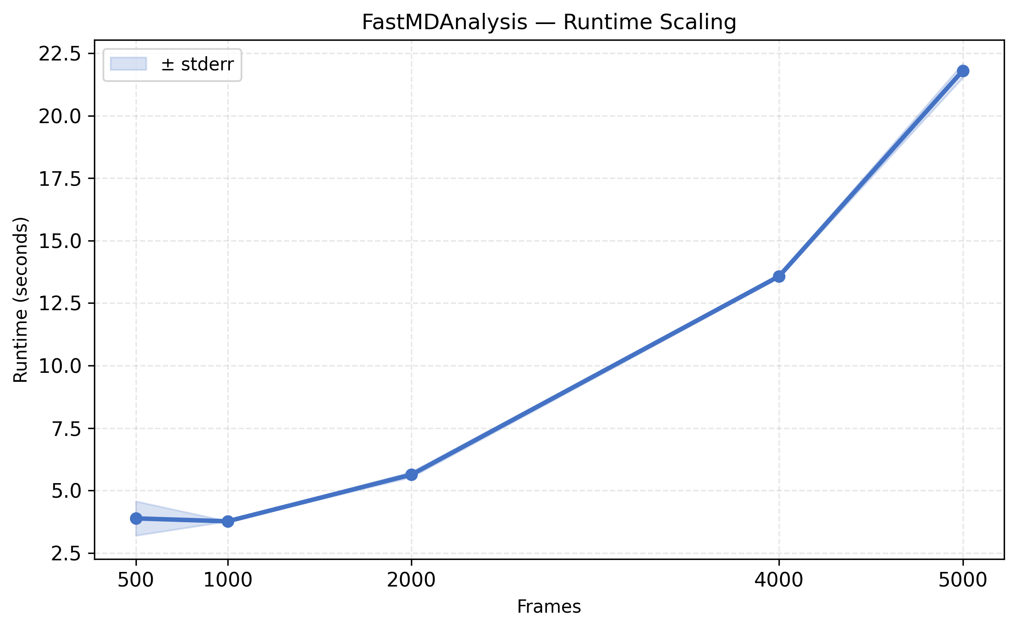
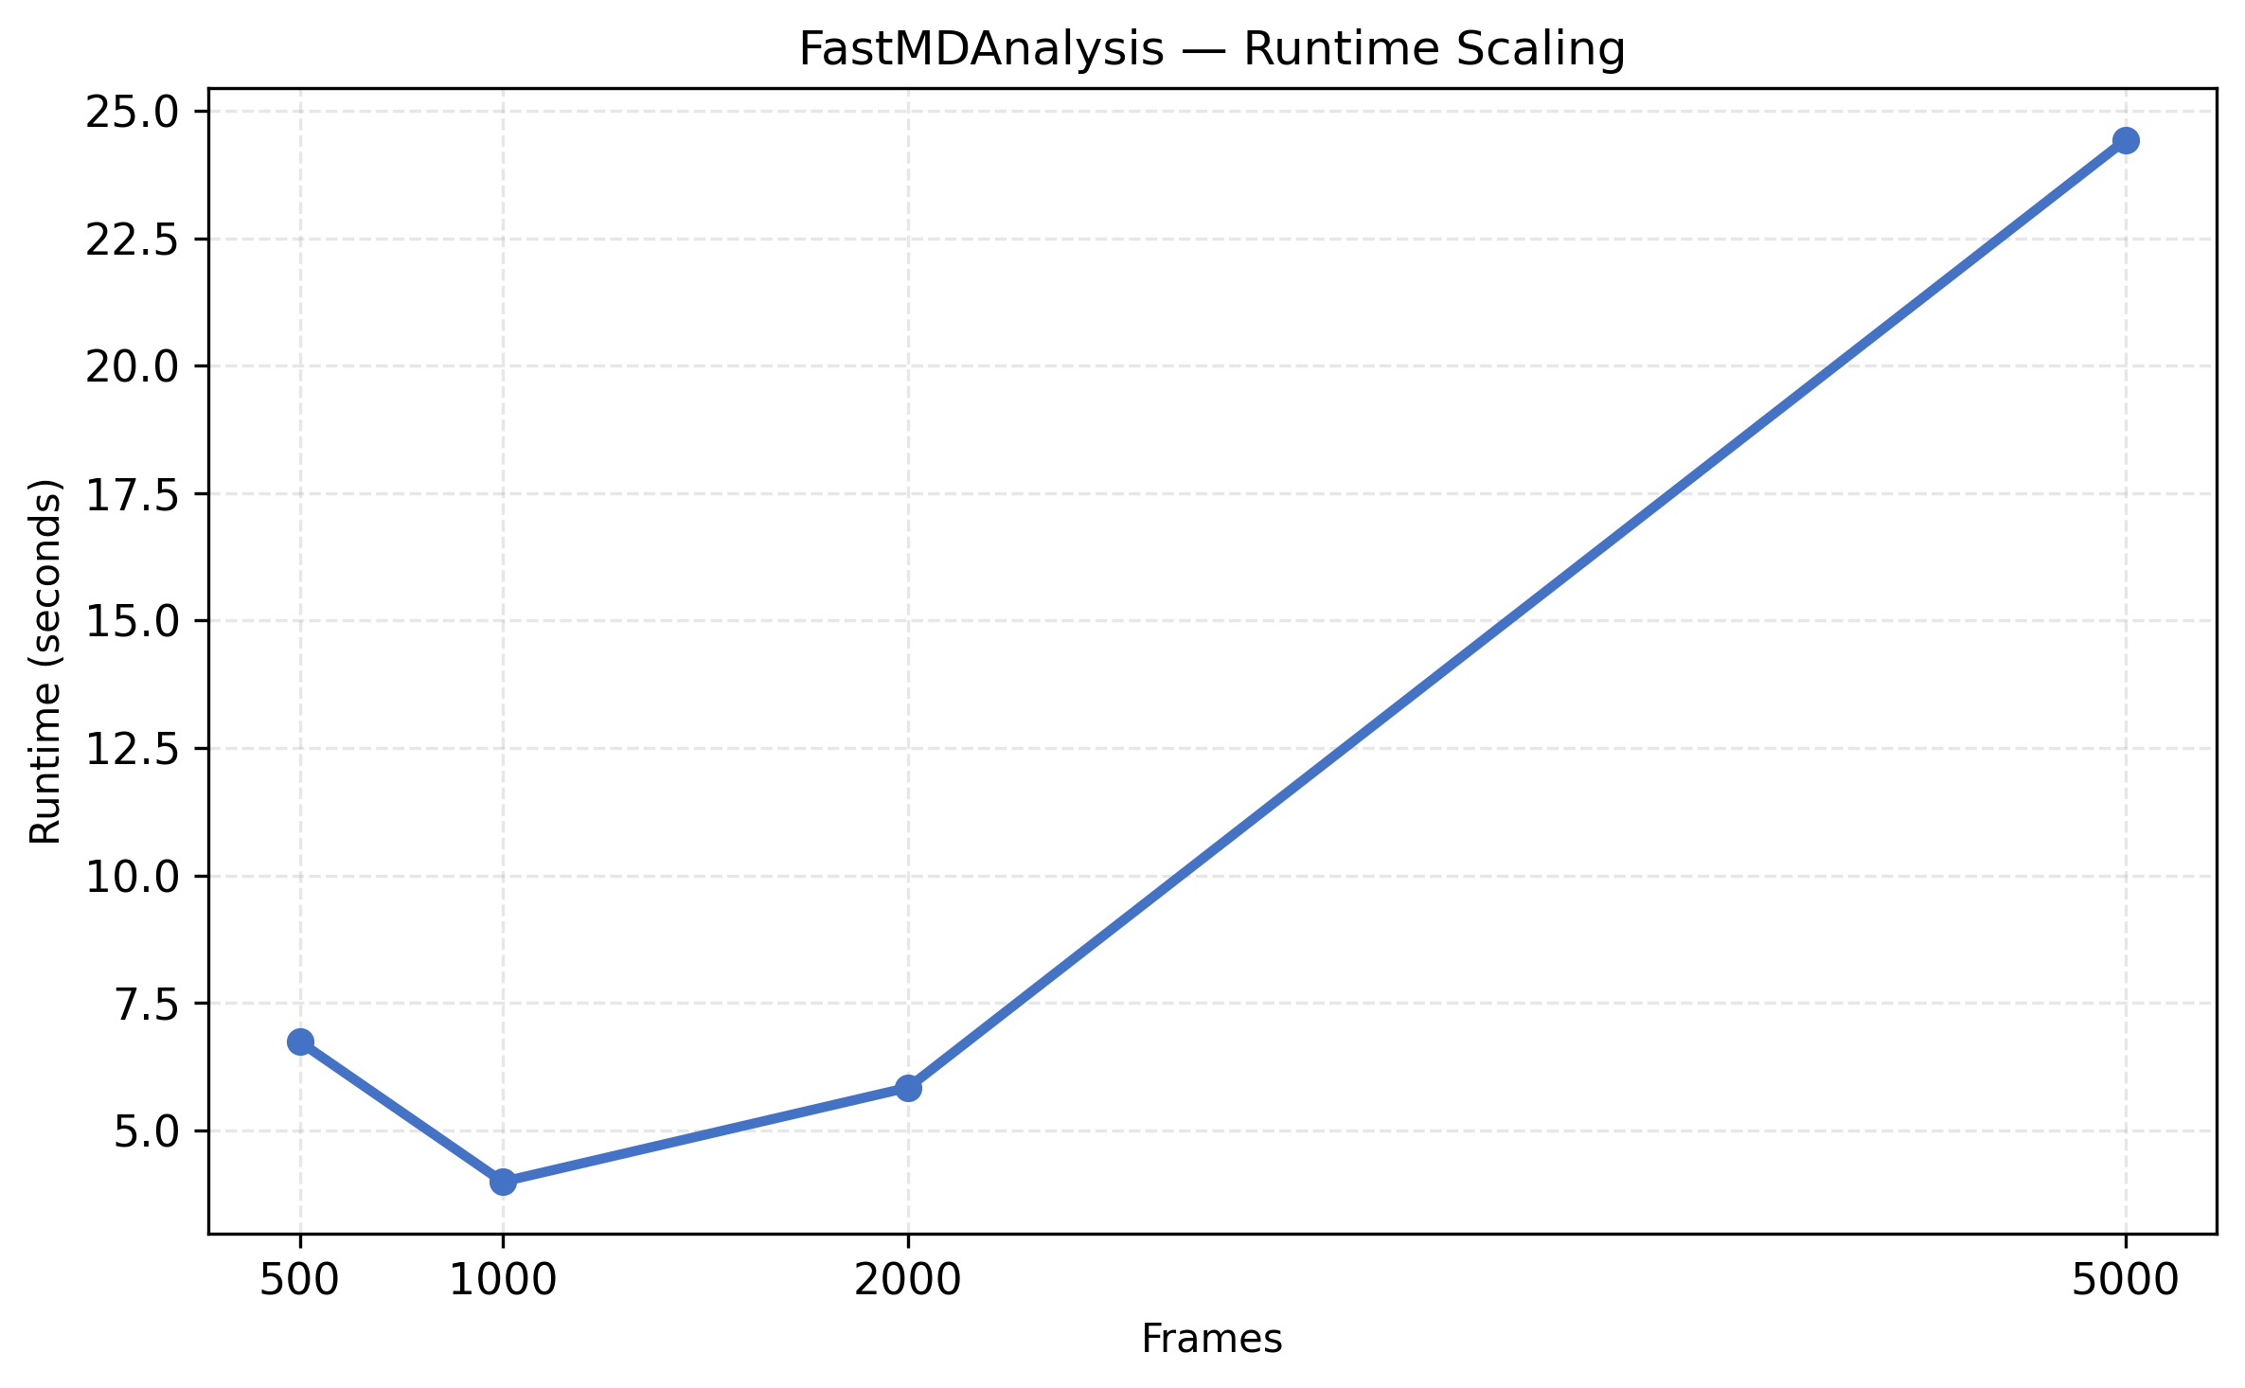
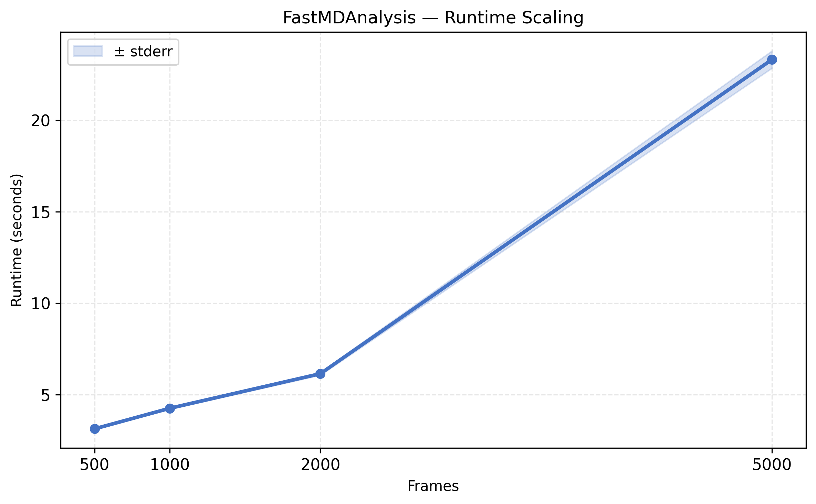
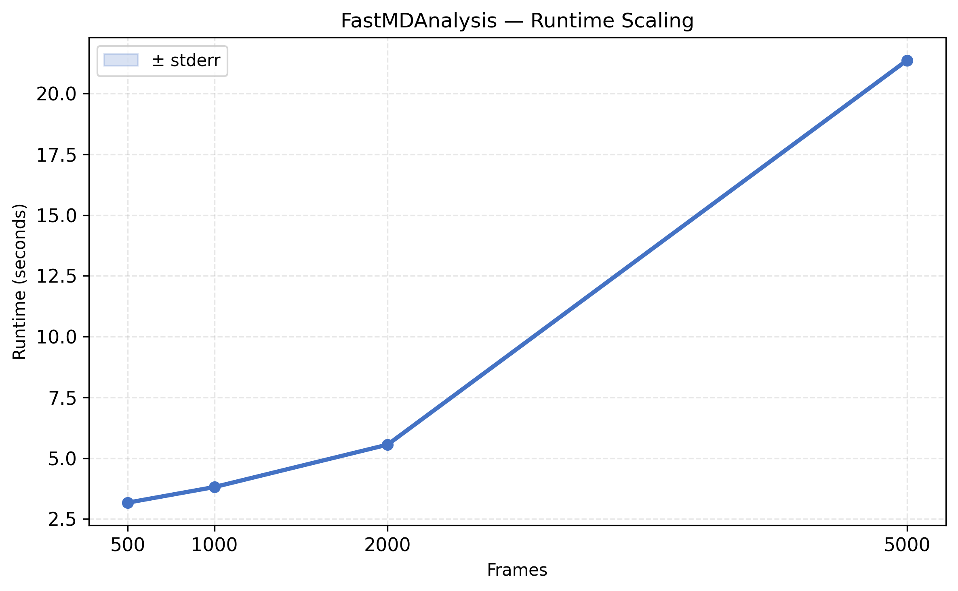
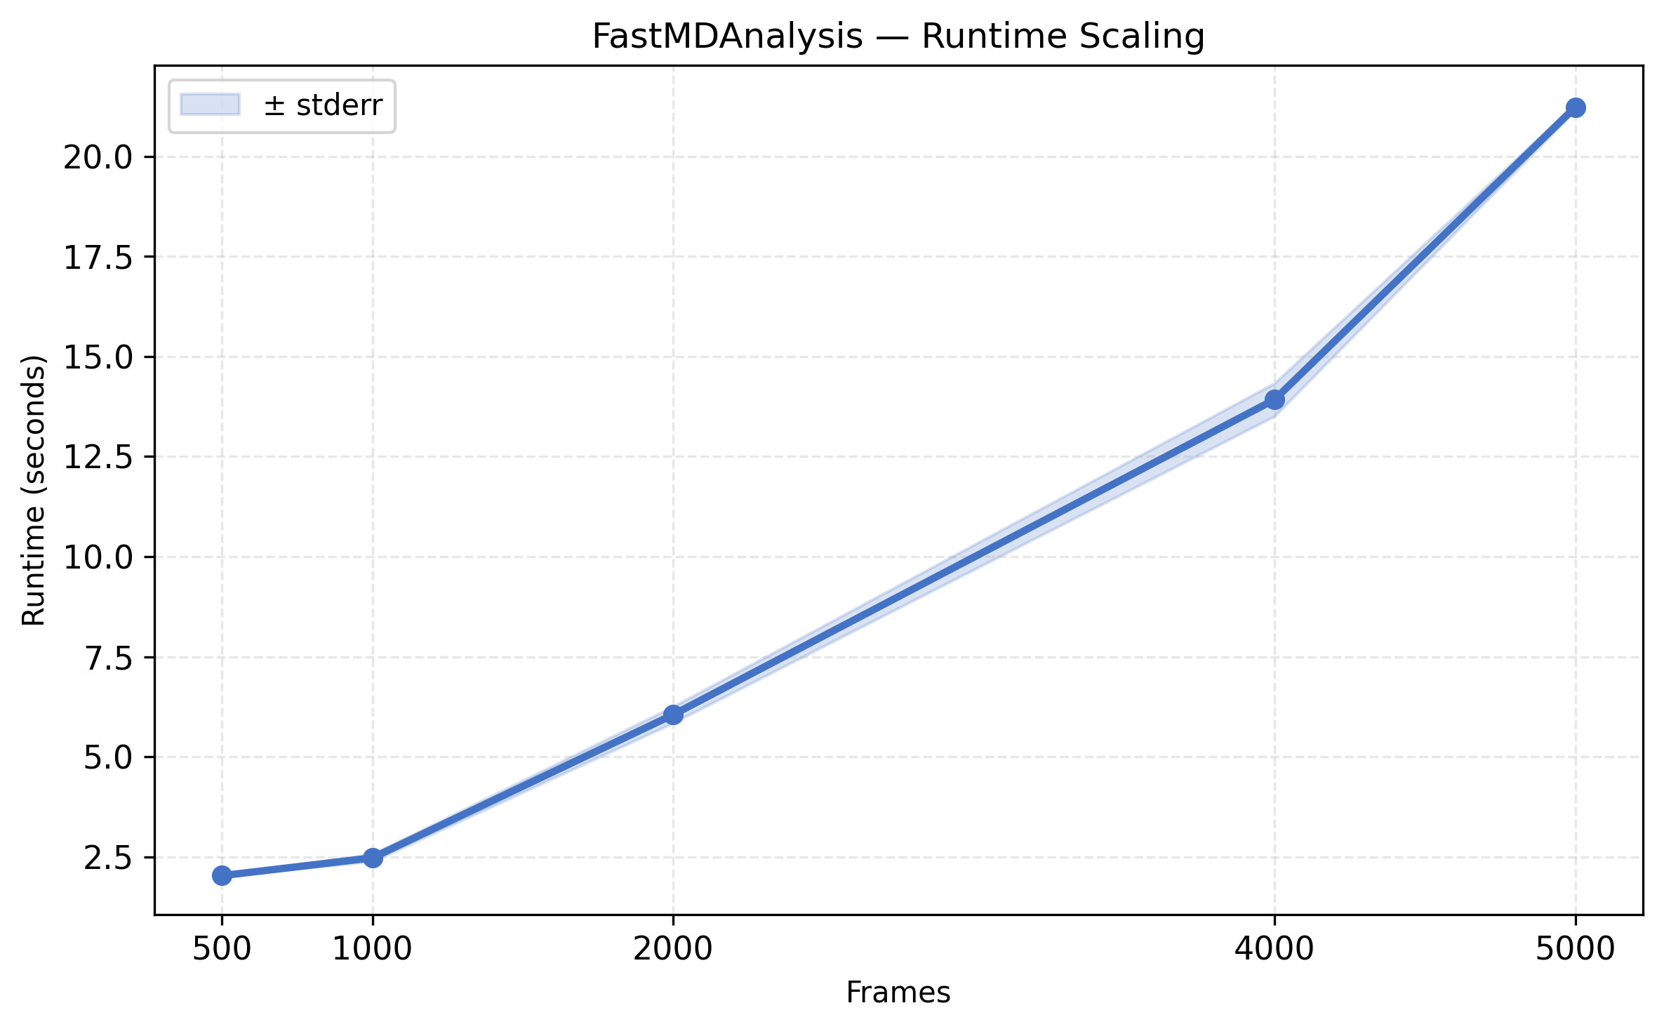
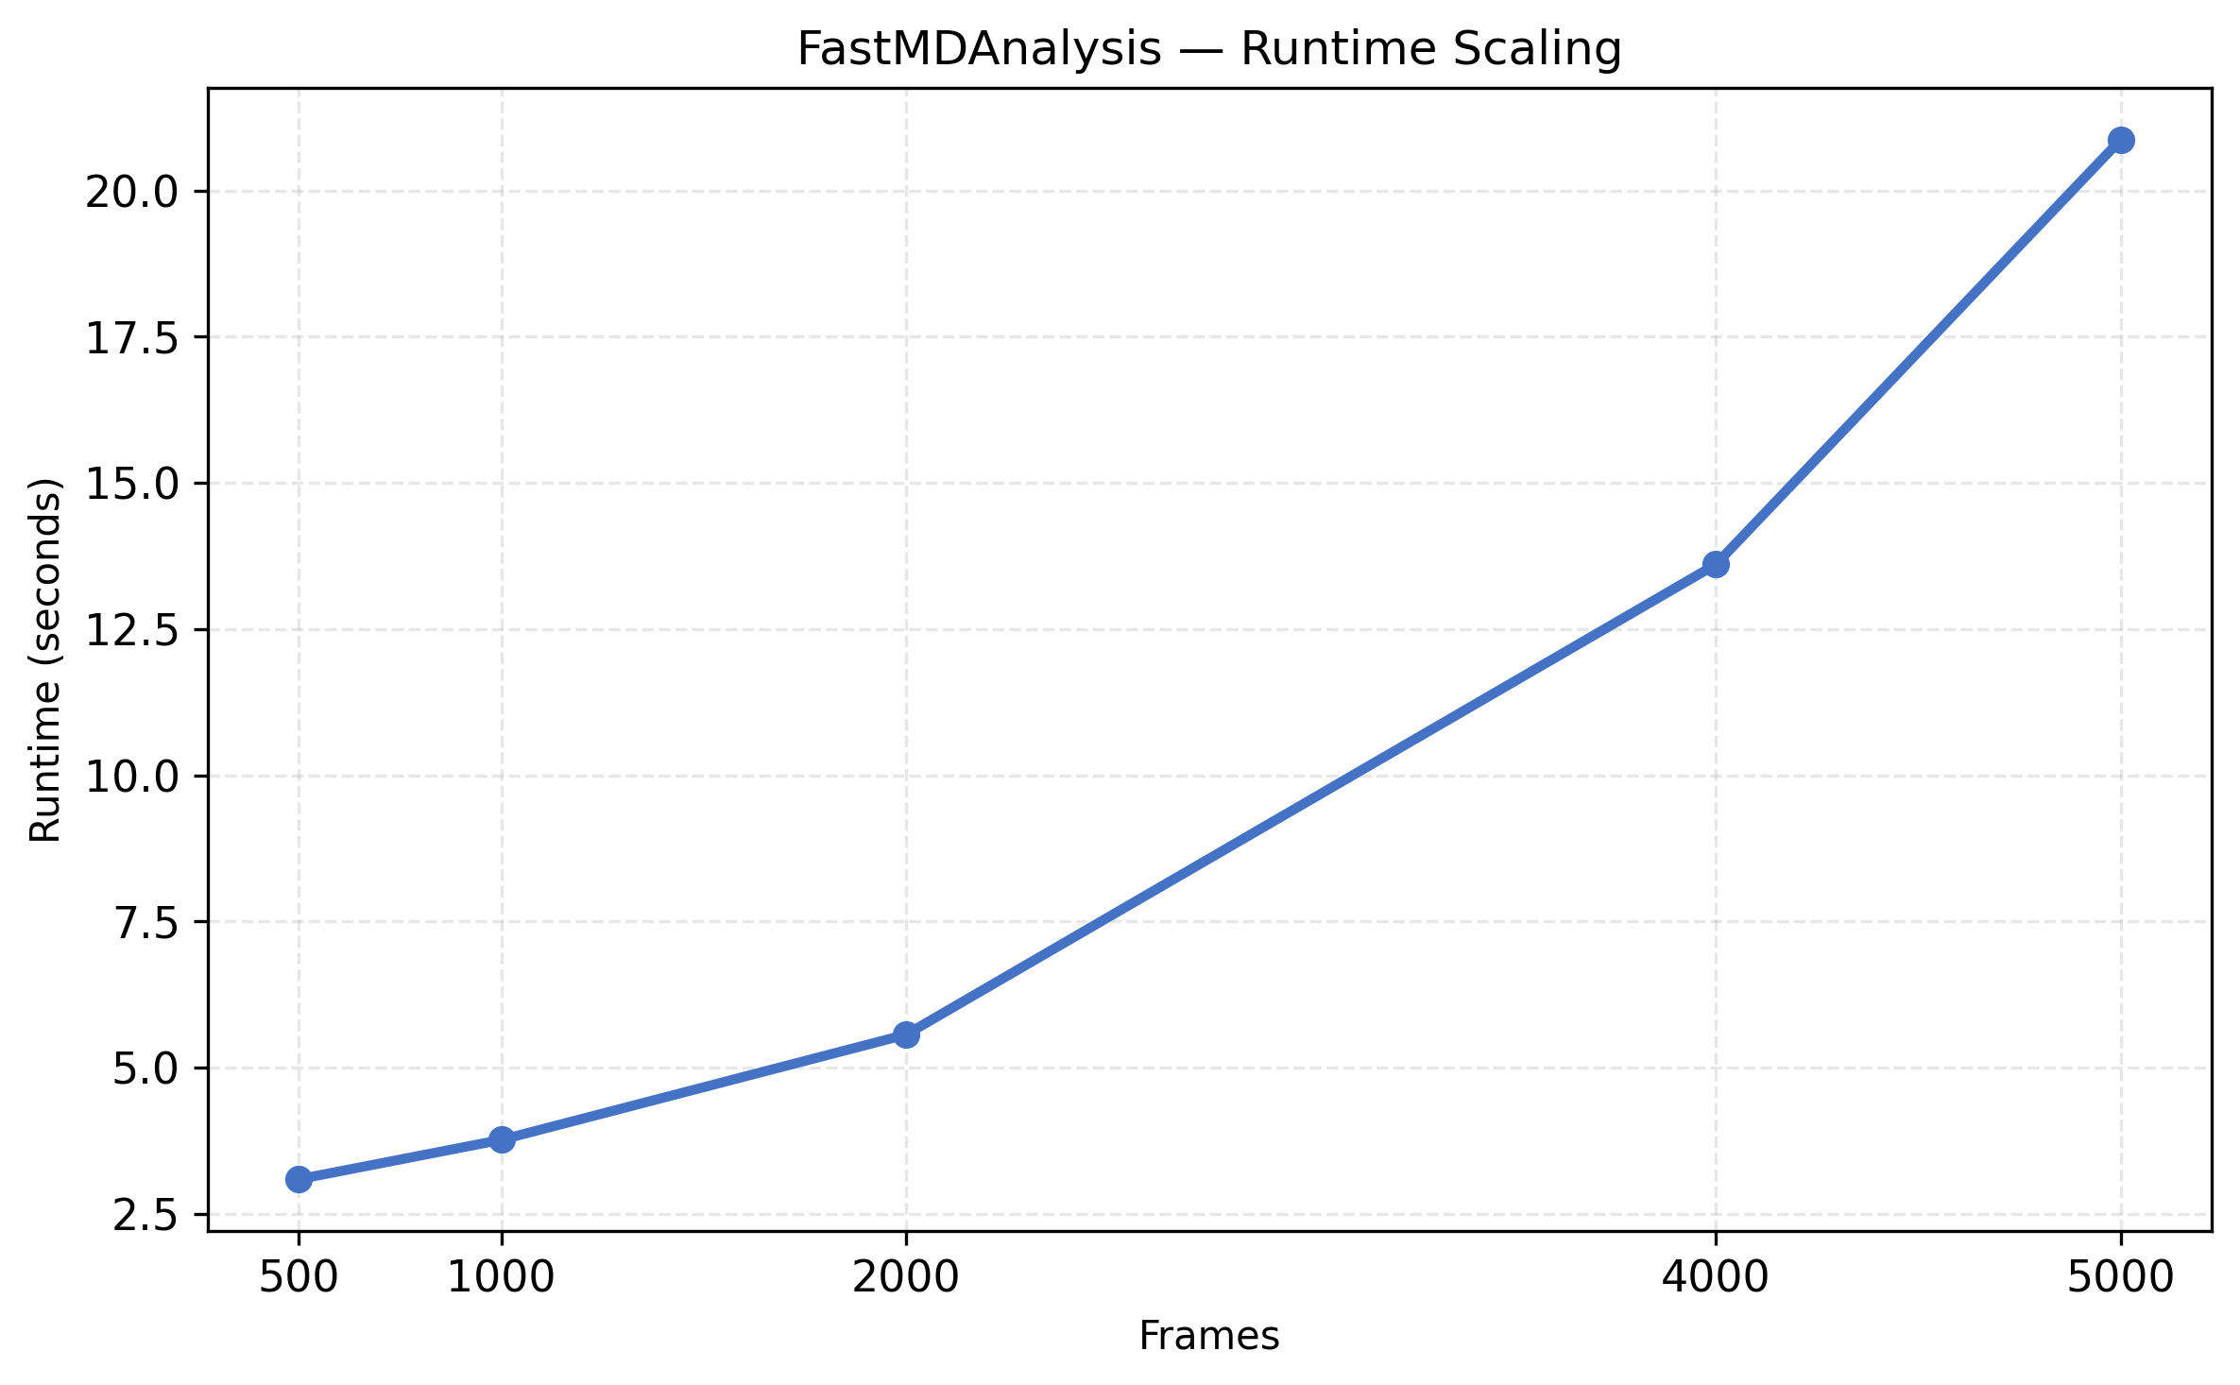
FastMDAnalysis Runtime Scaling

Slide 7
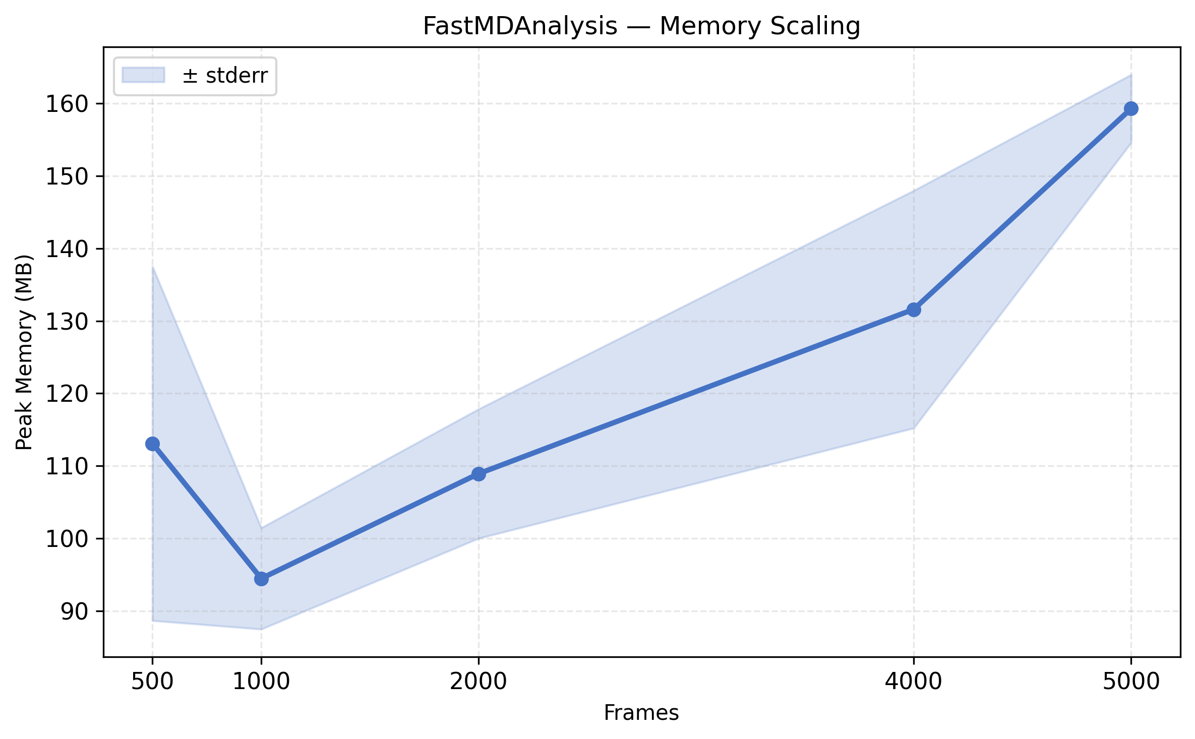
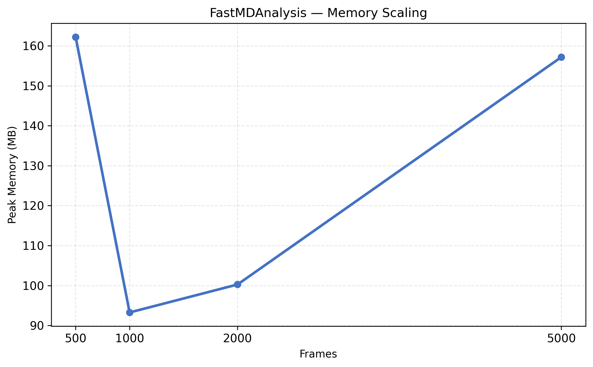
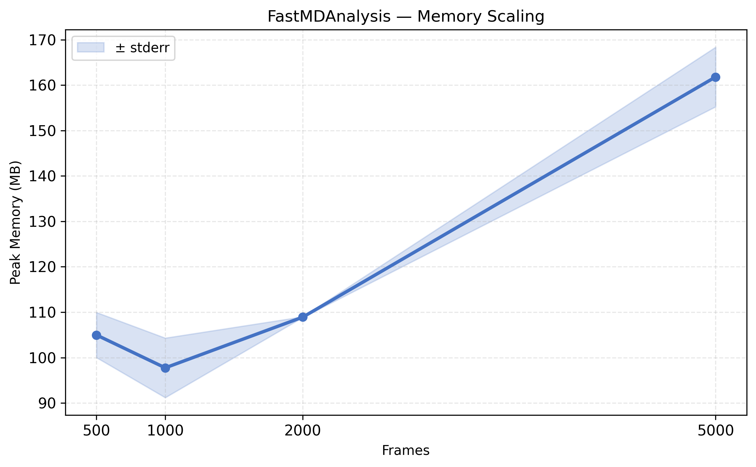
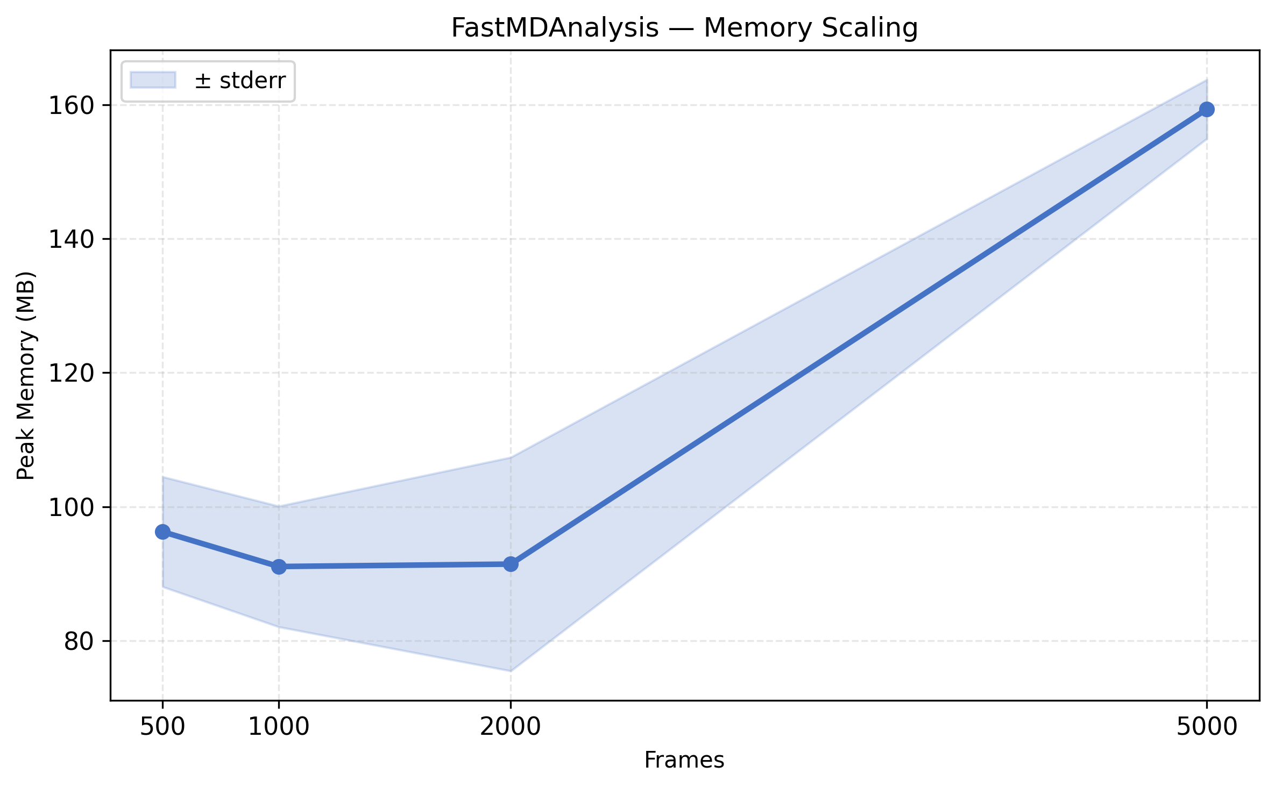
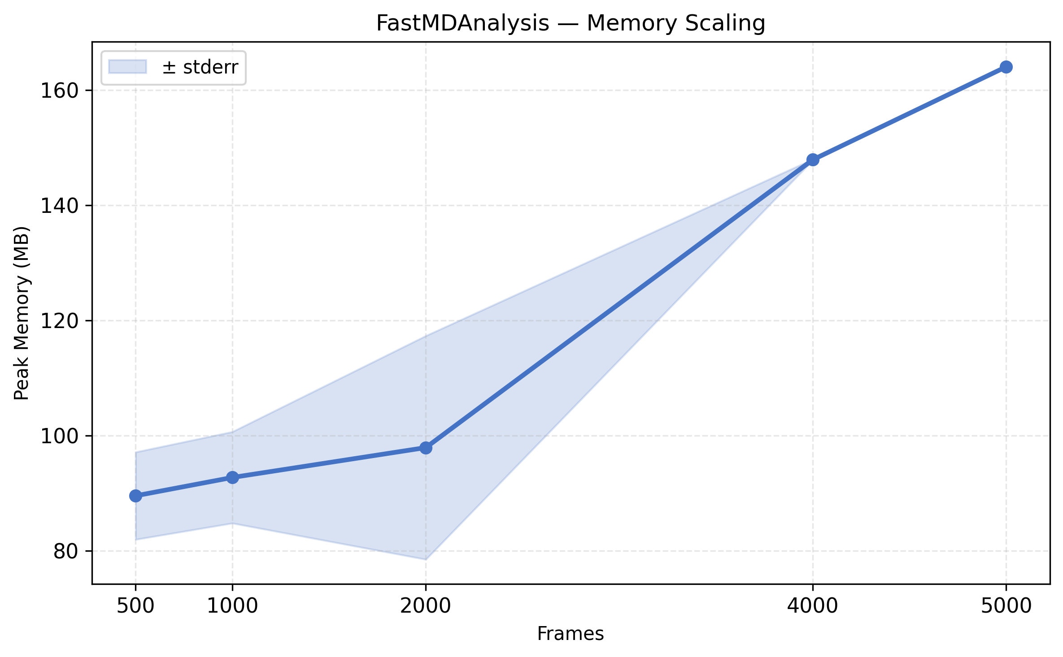
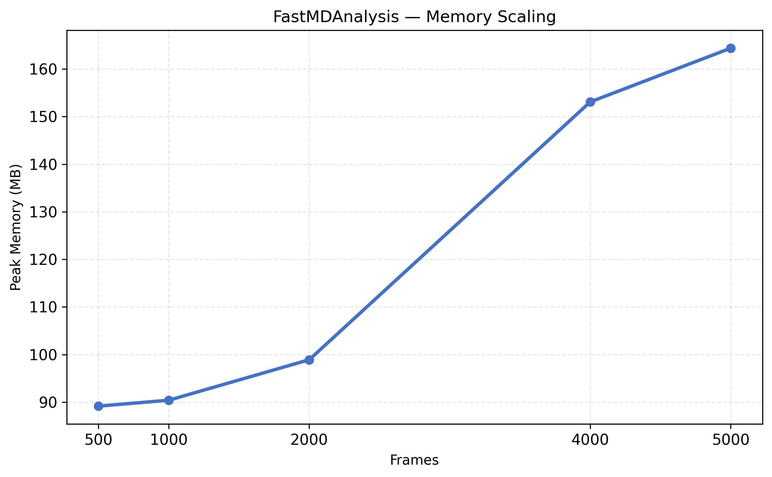
FastMDAnalysis Memory Scaling

Slide 8
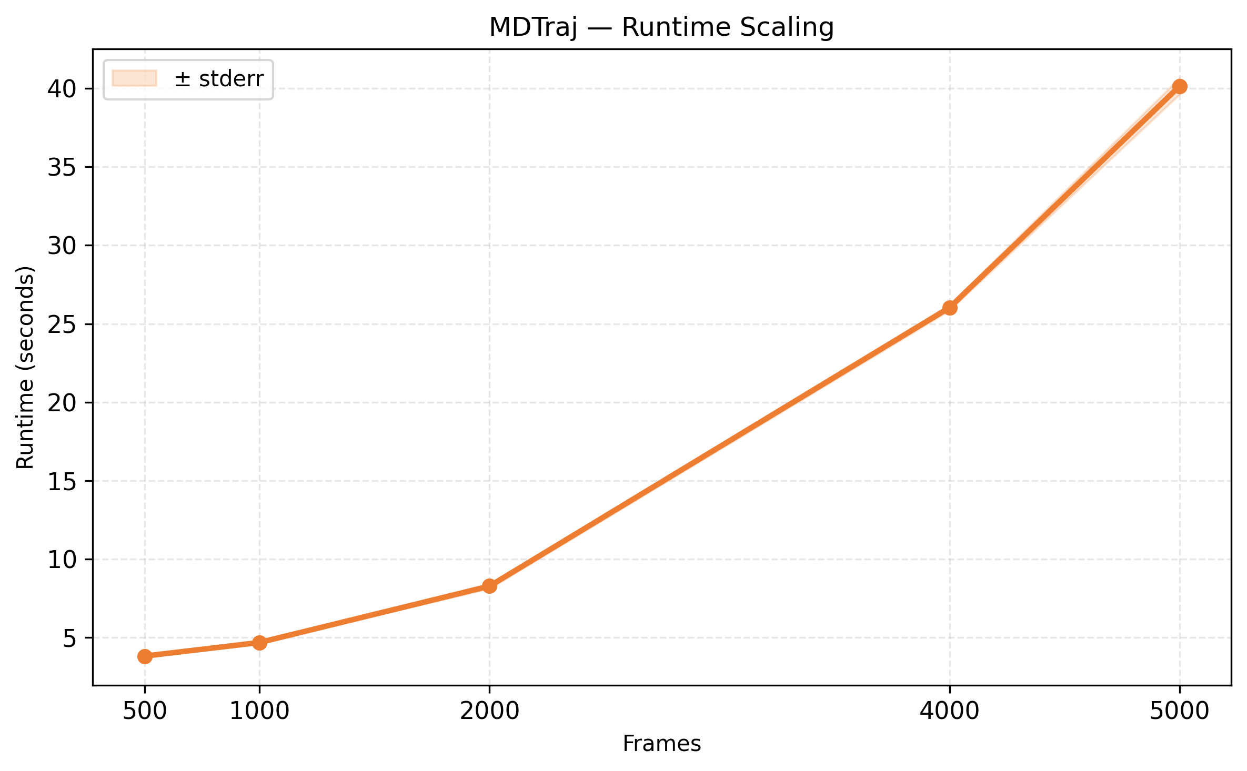
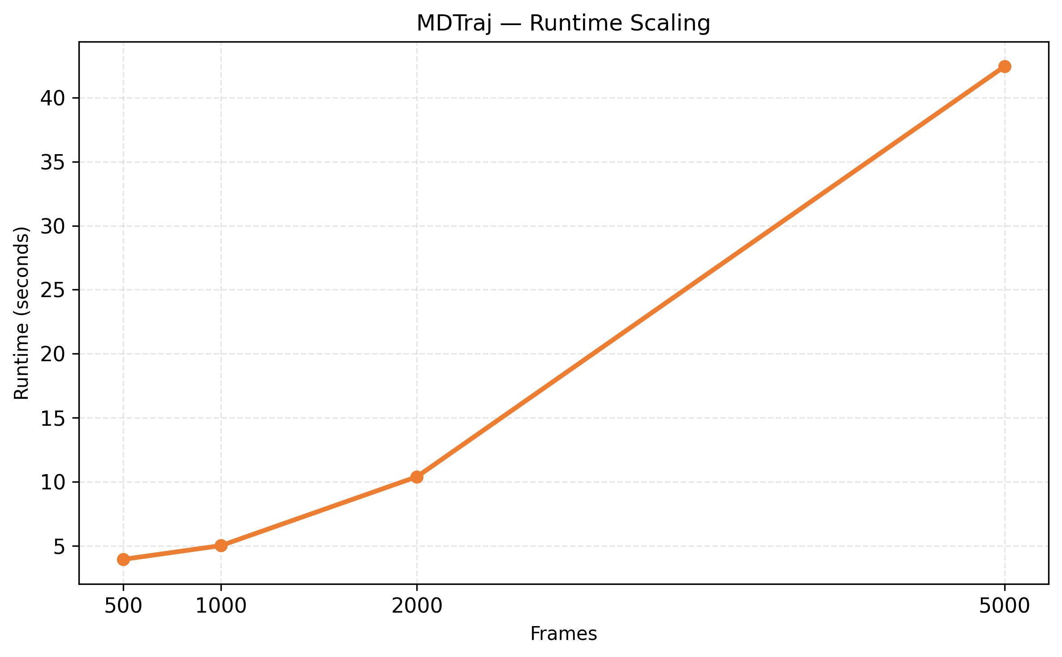
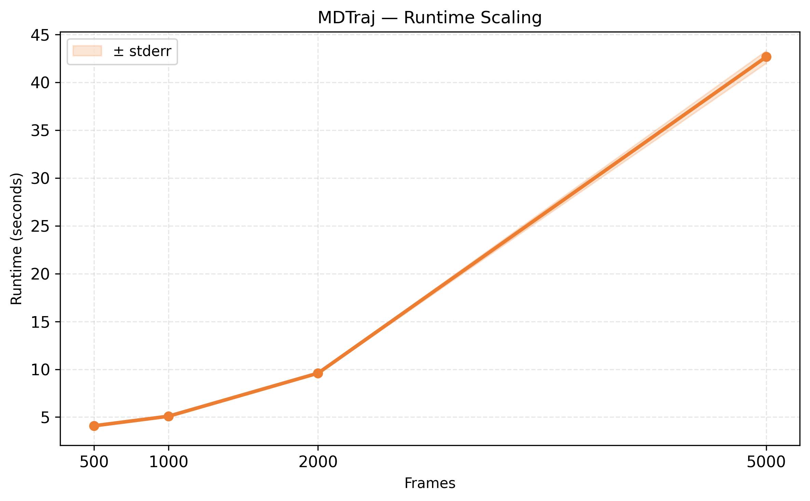
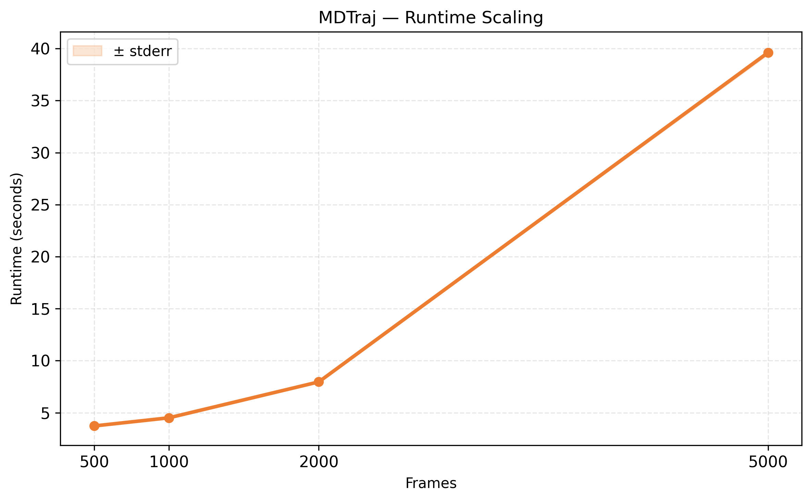
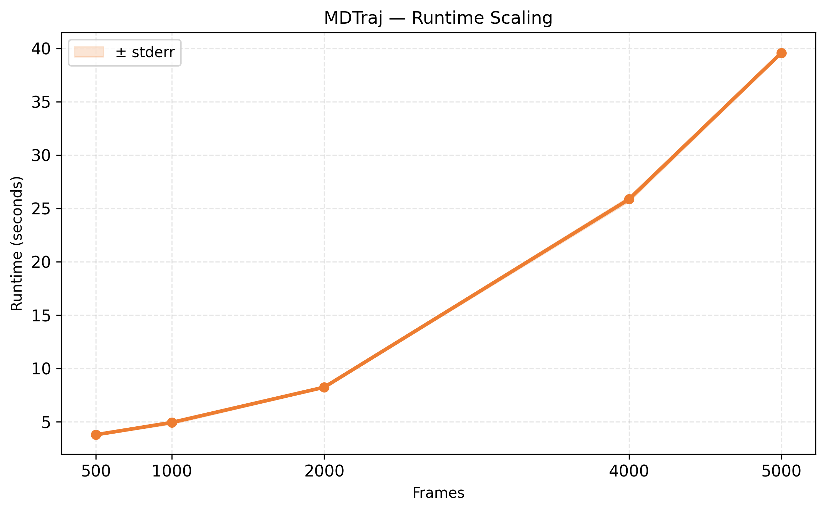
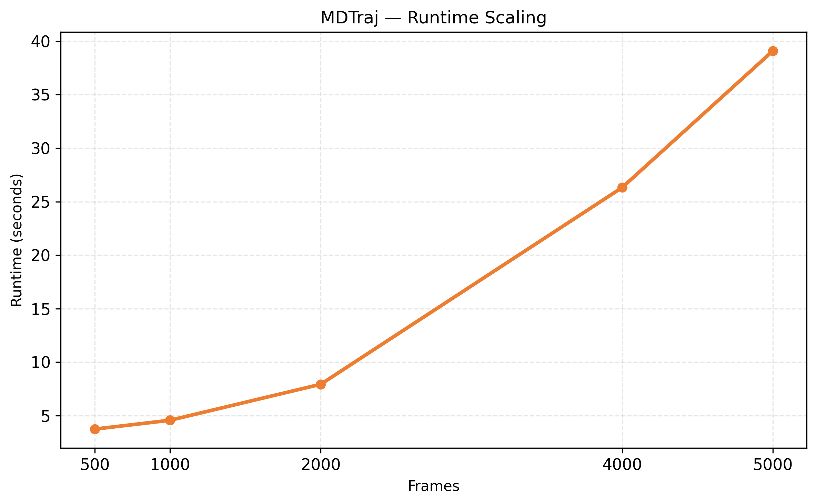
MDTraj Runtime Scaling

Slide 9
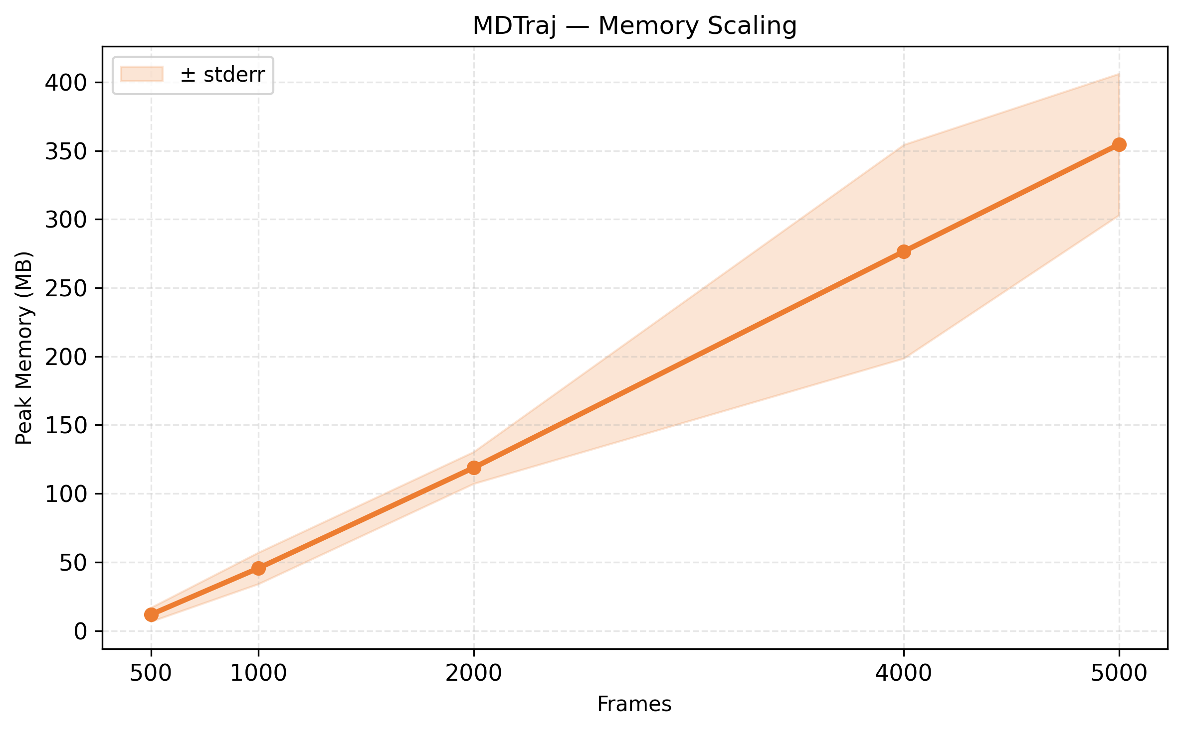
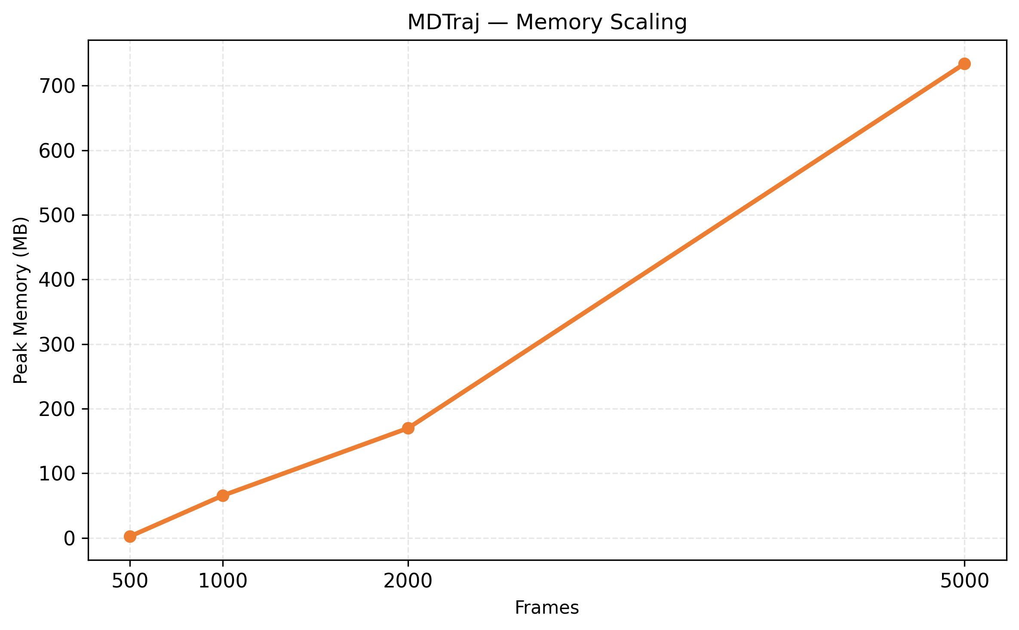
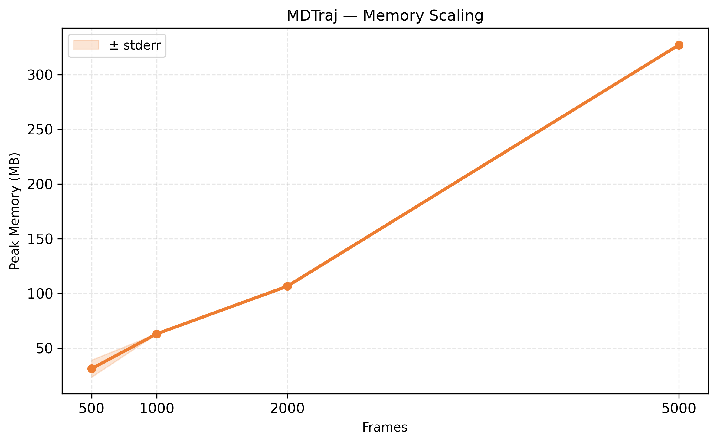
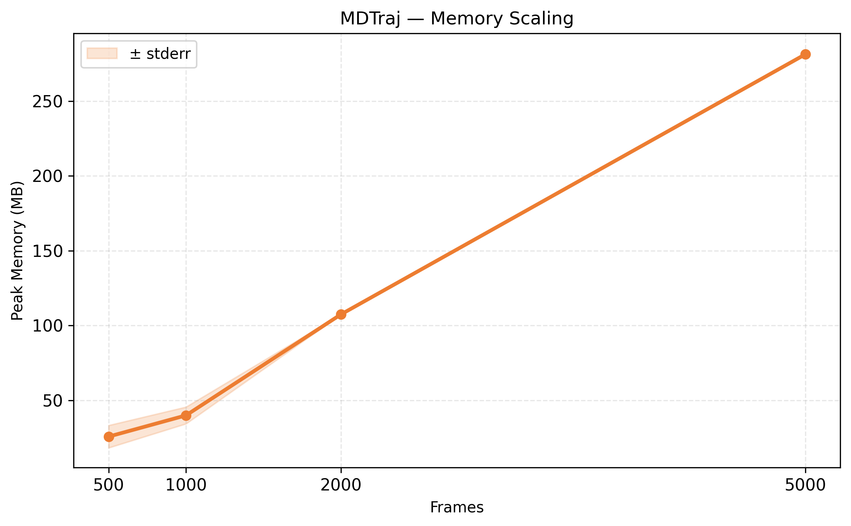
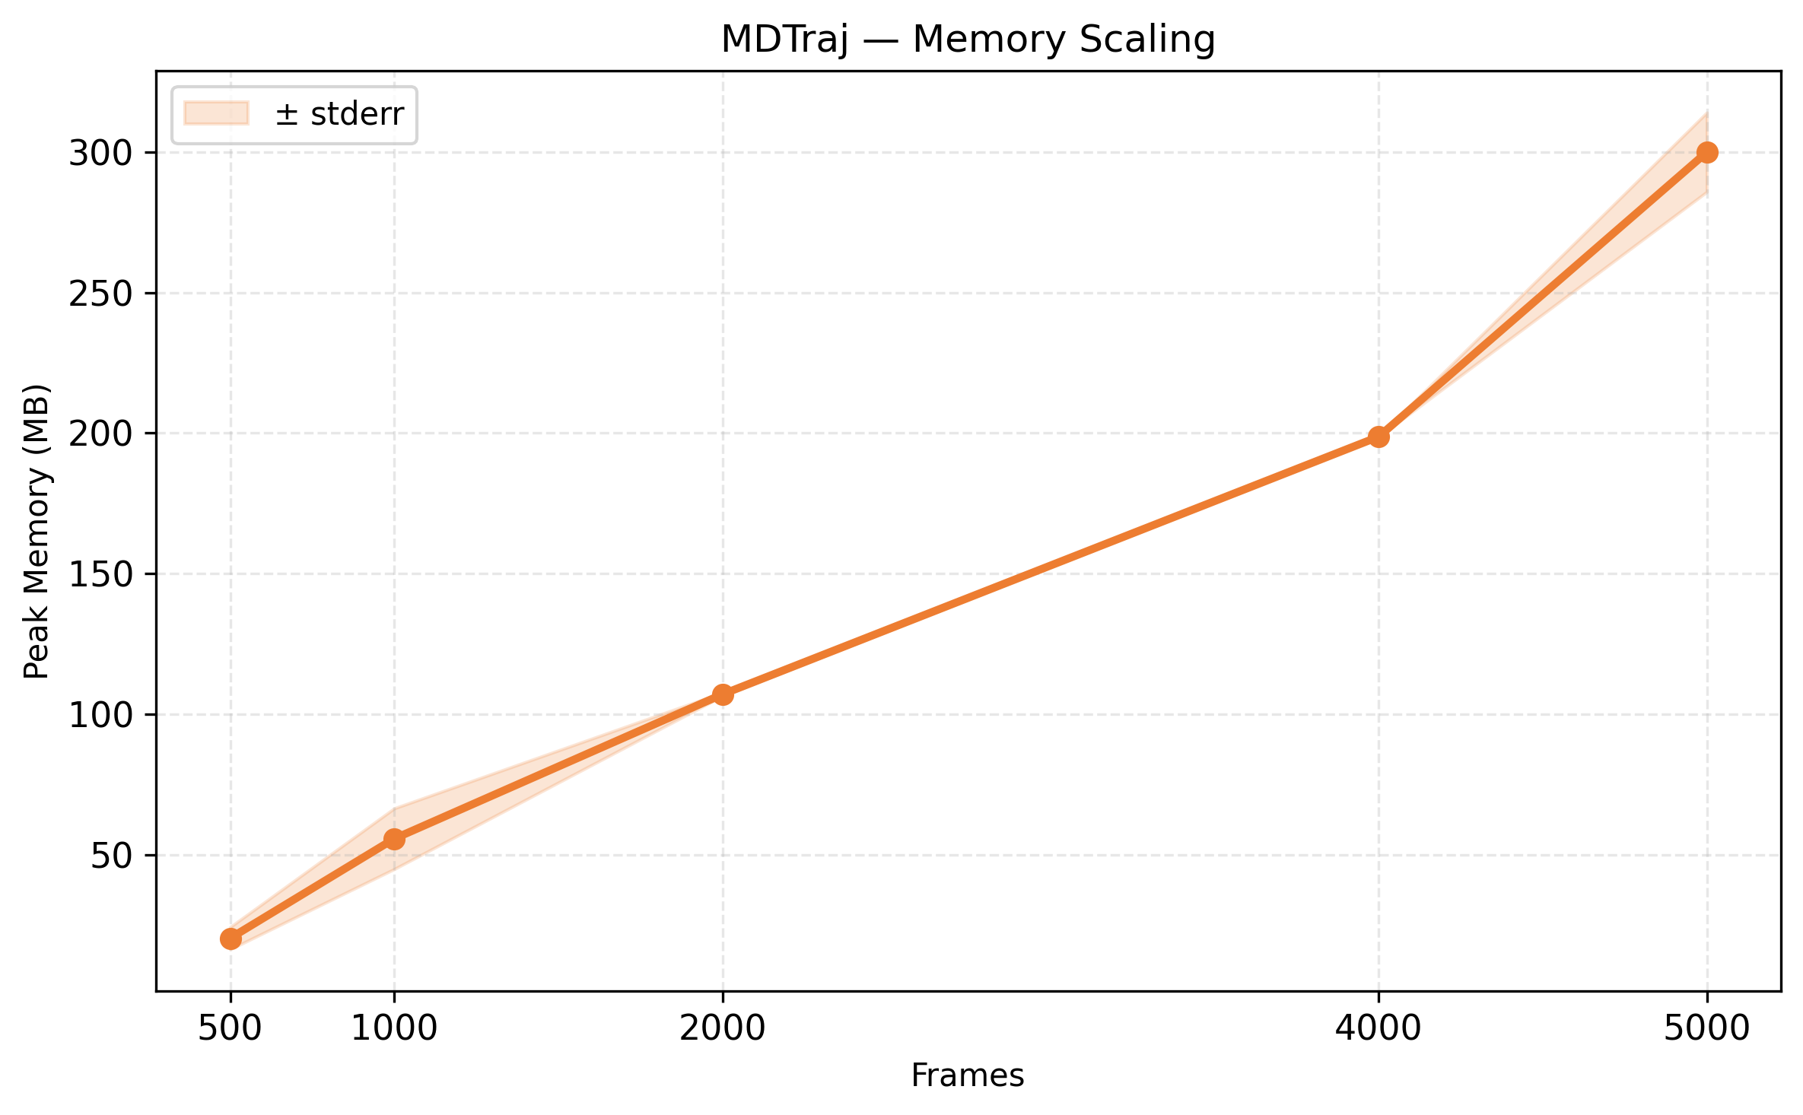
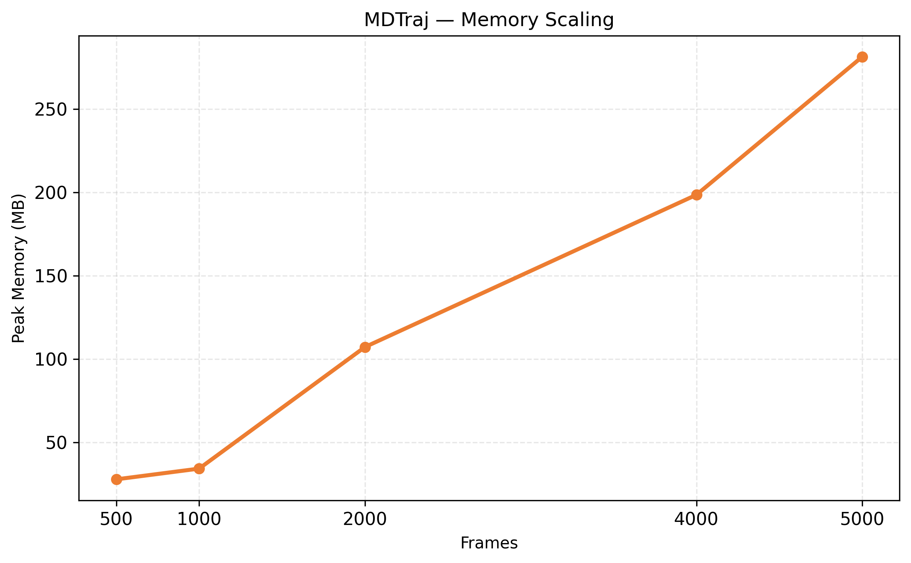
MDTraj Memory Scaling

Slide 10
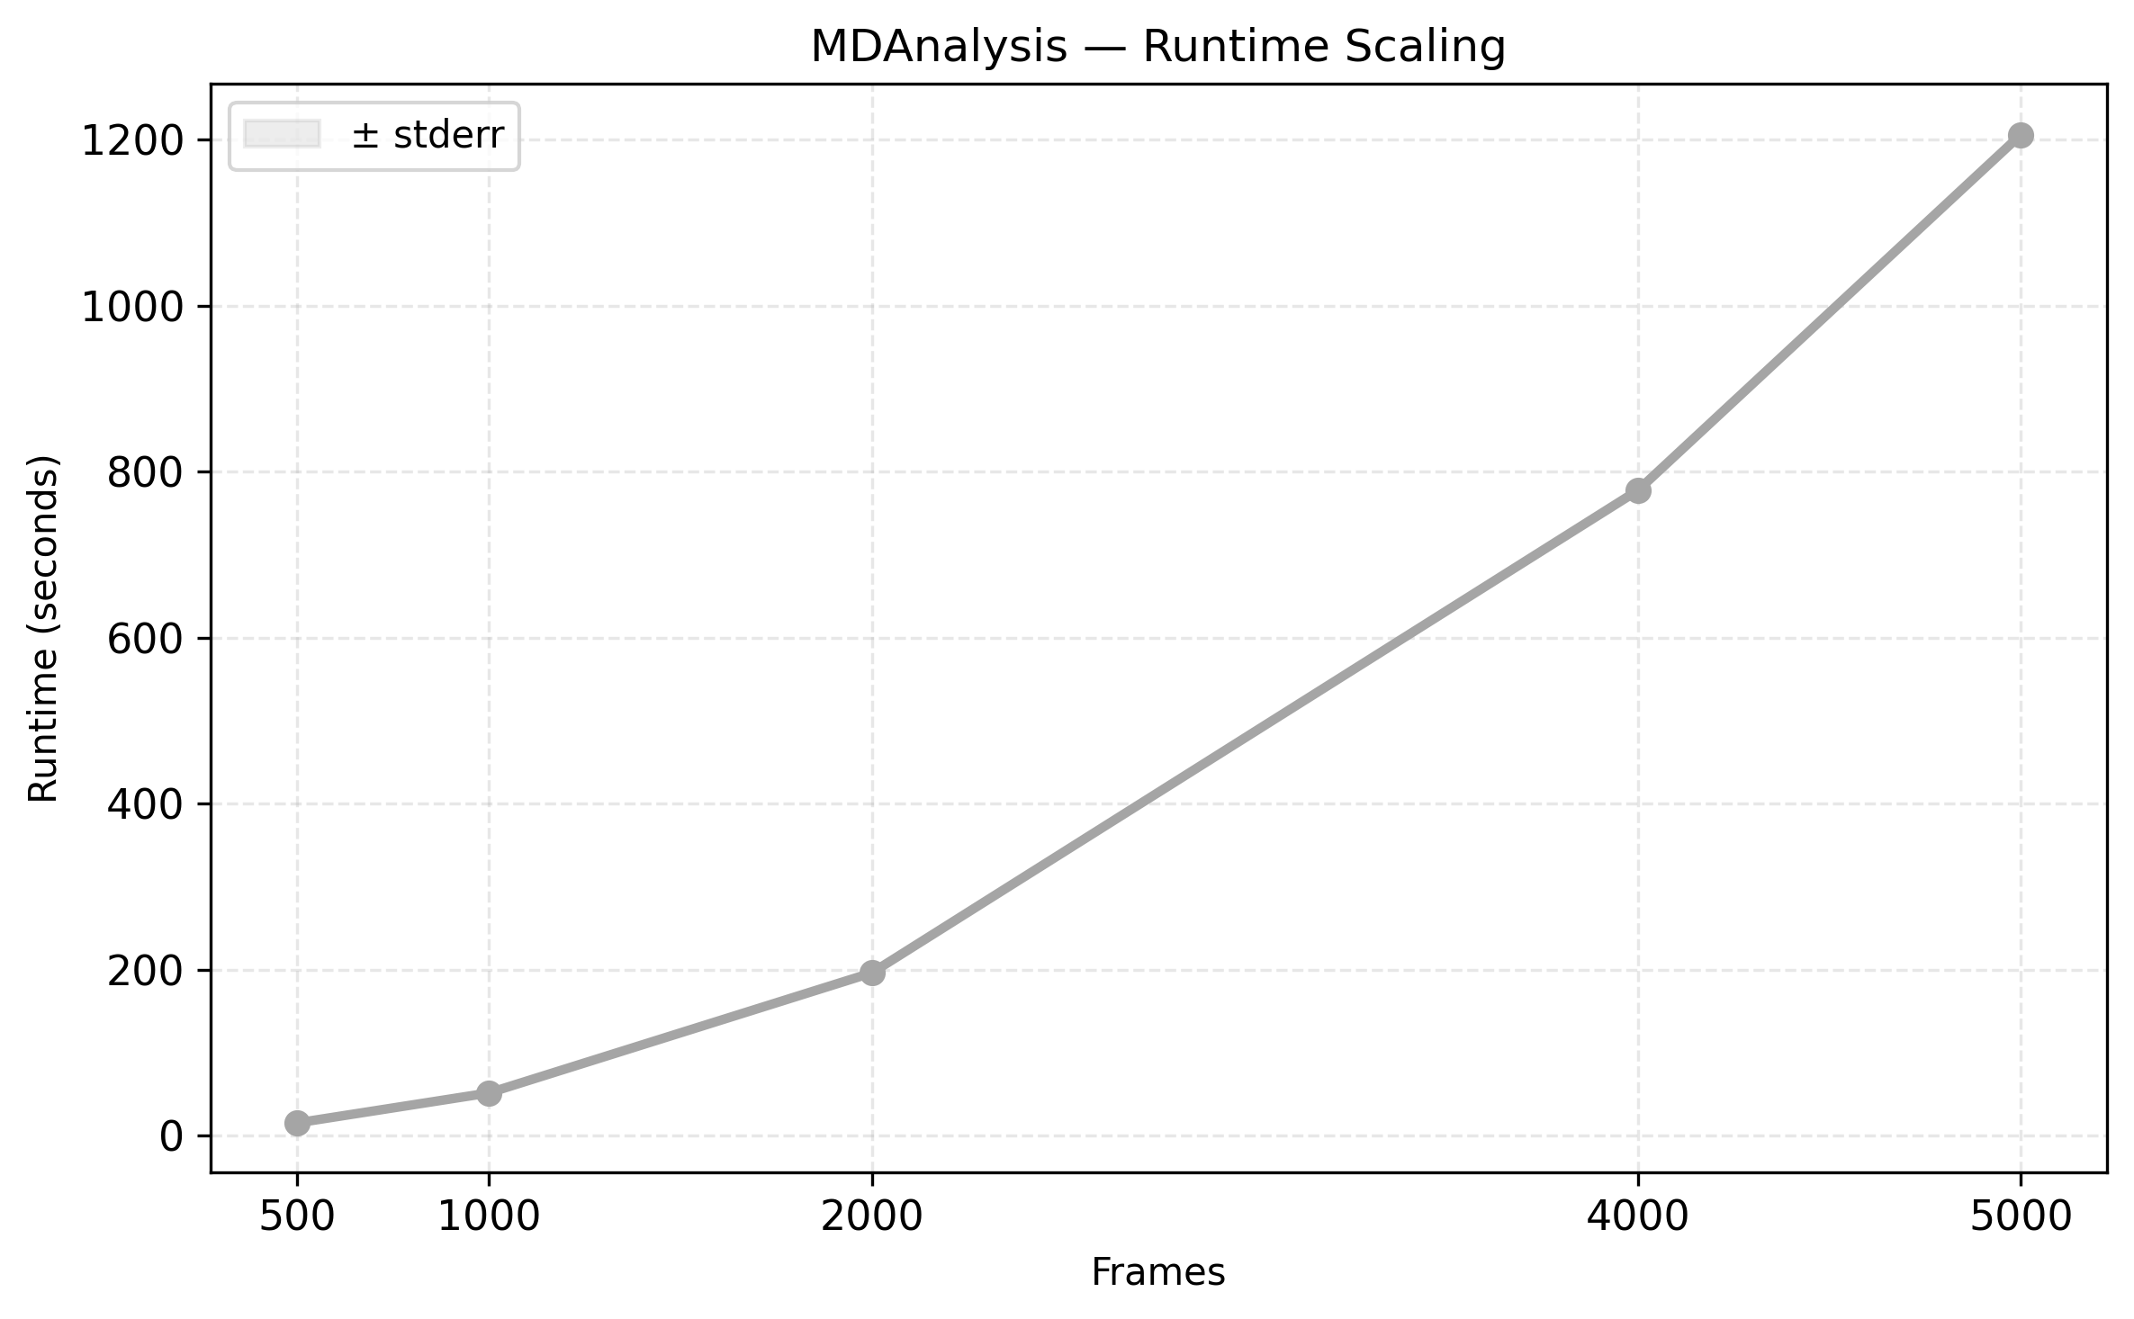
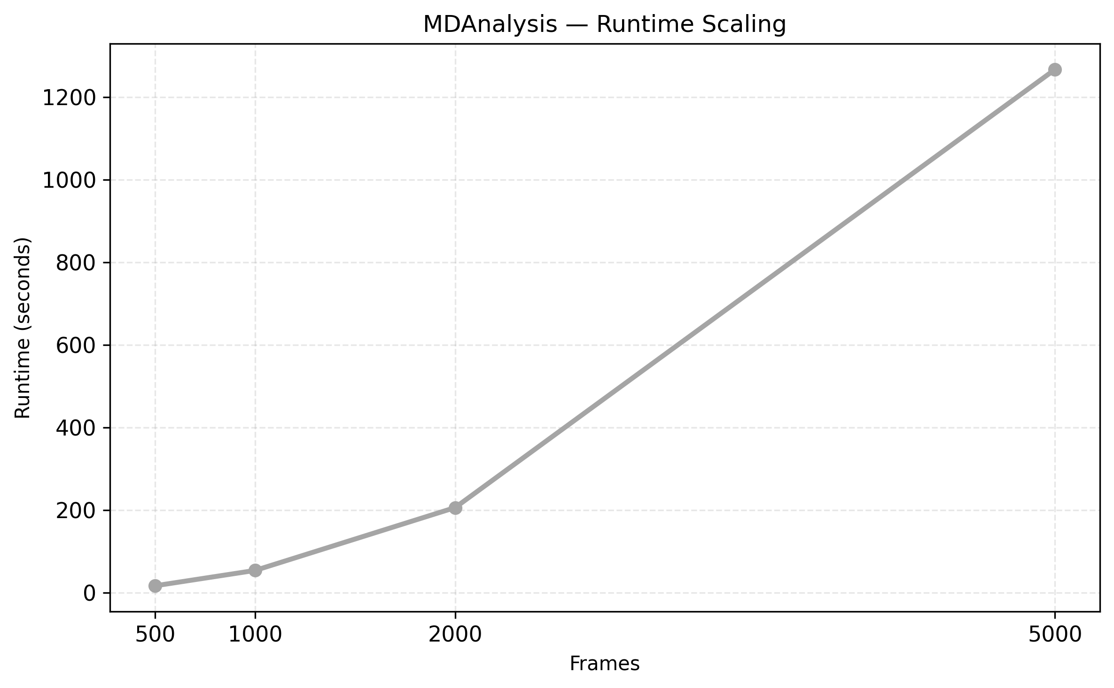
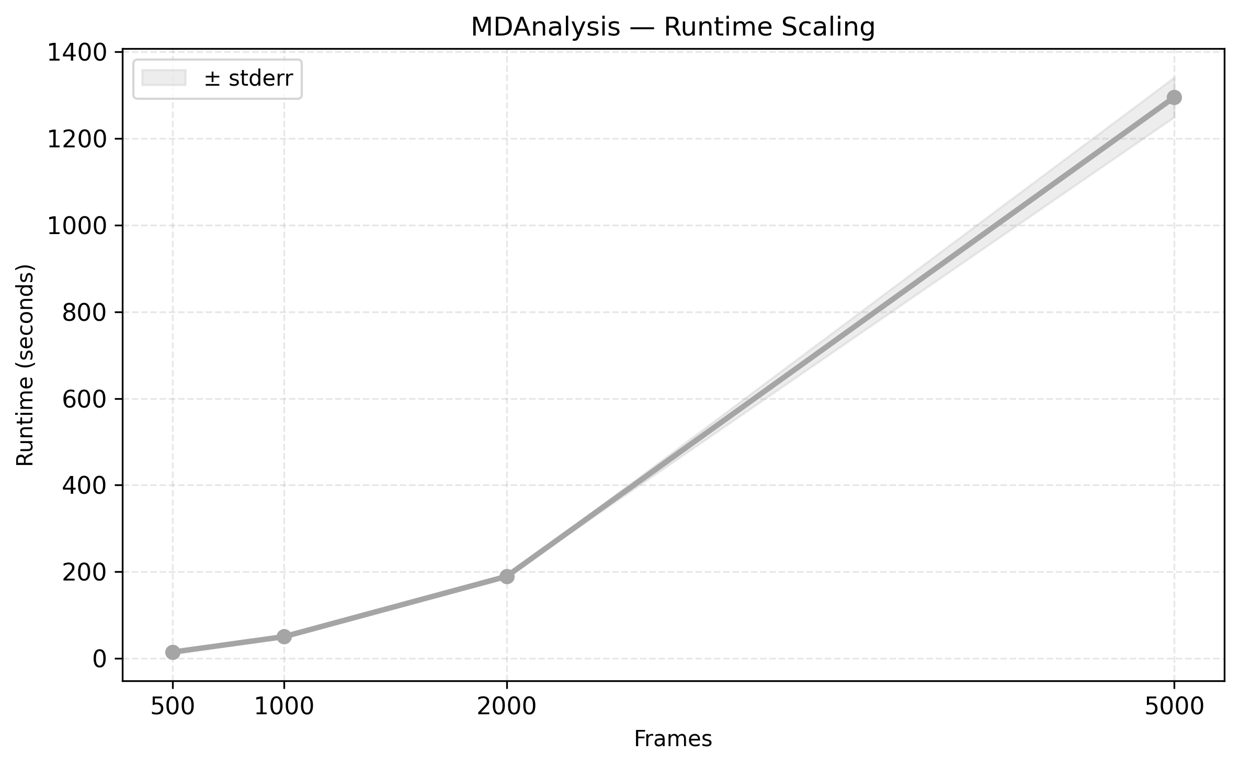
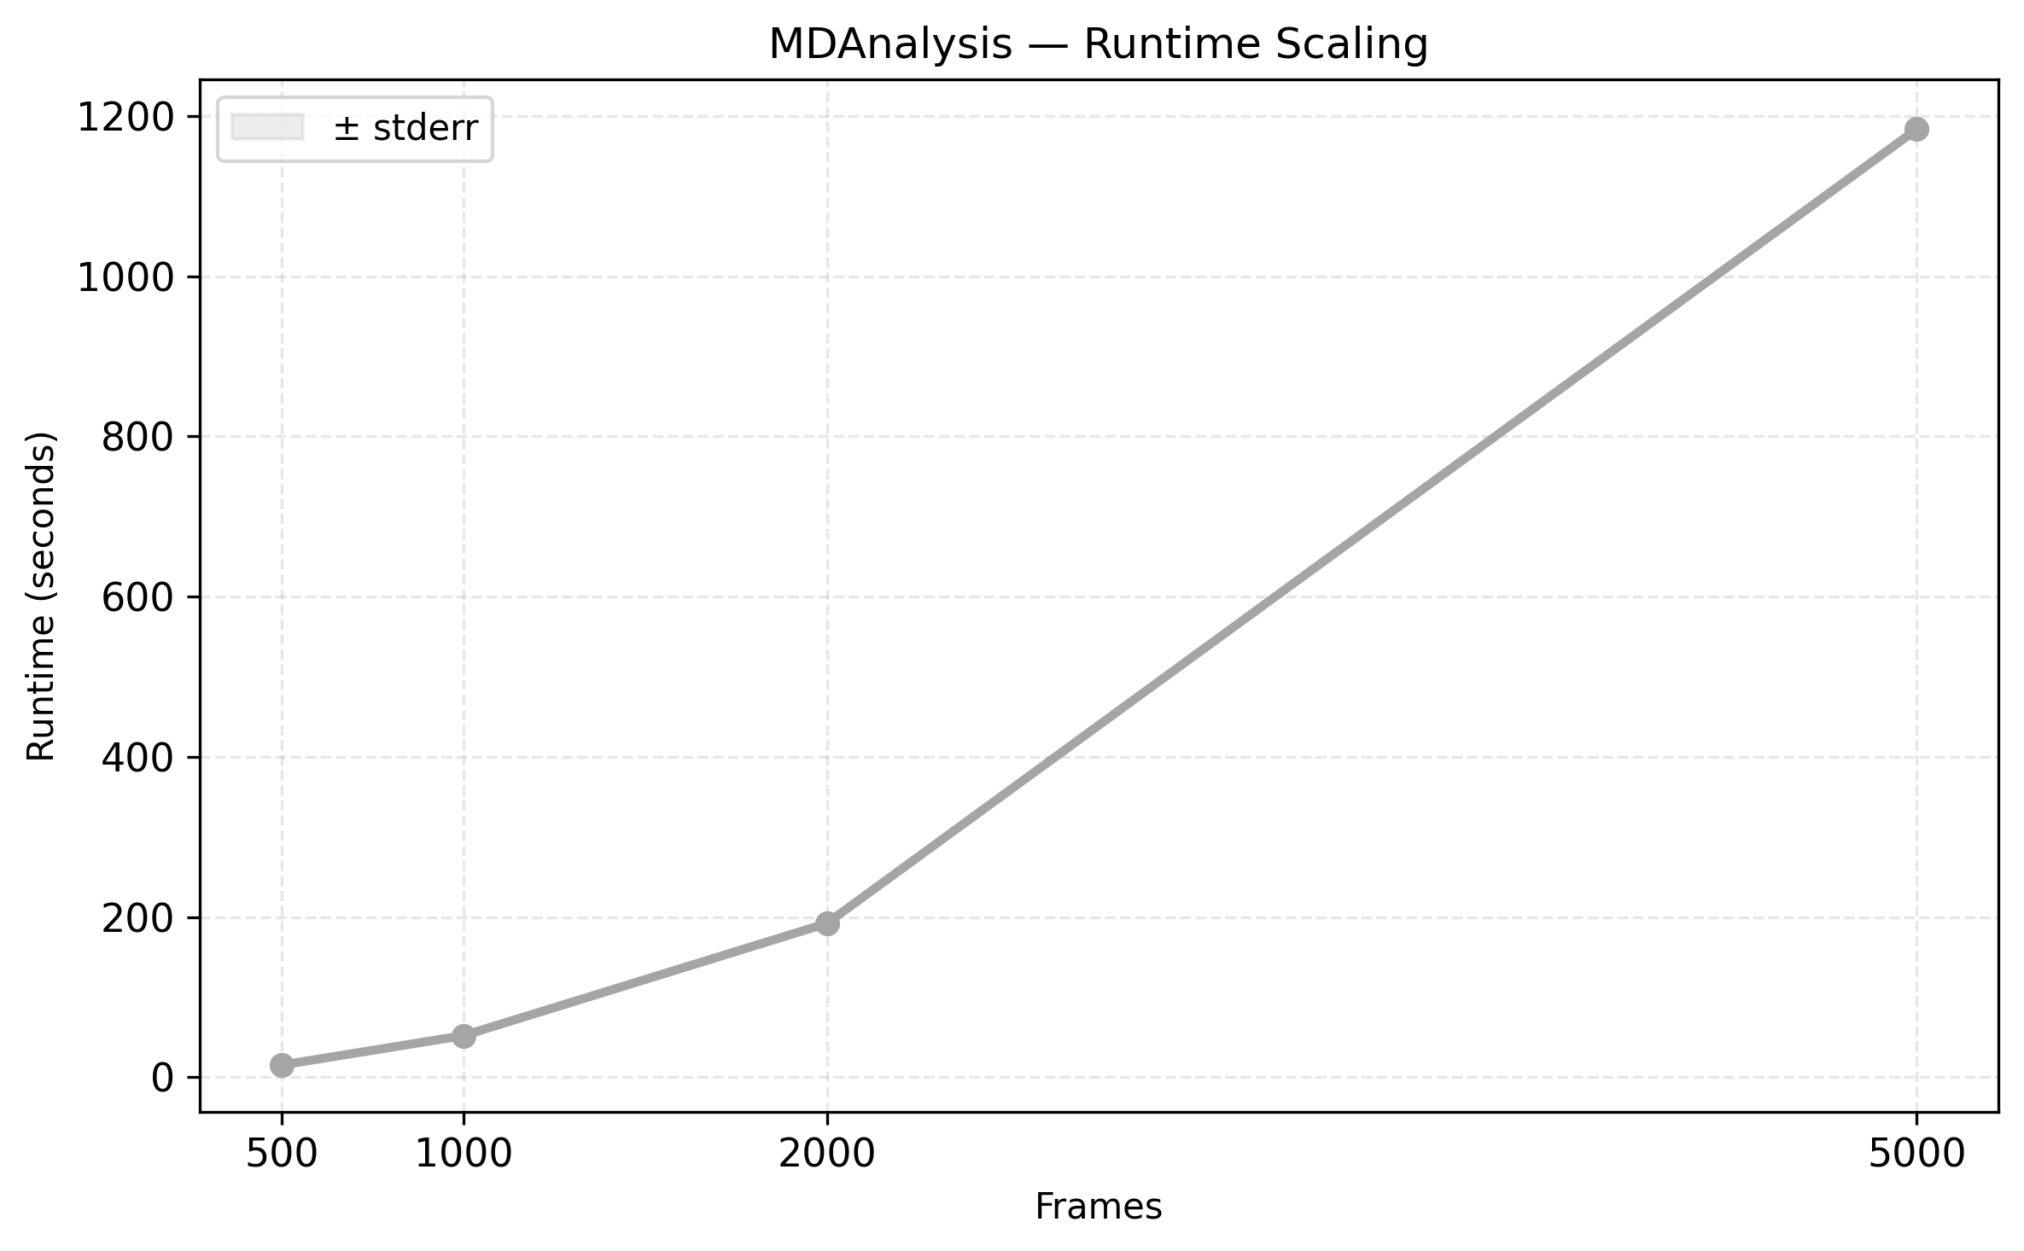

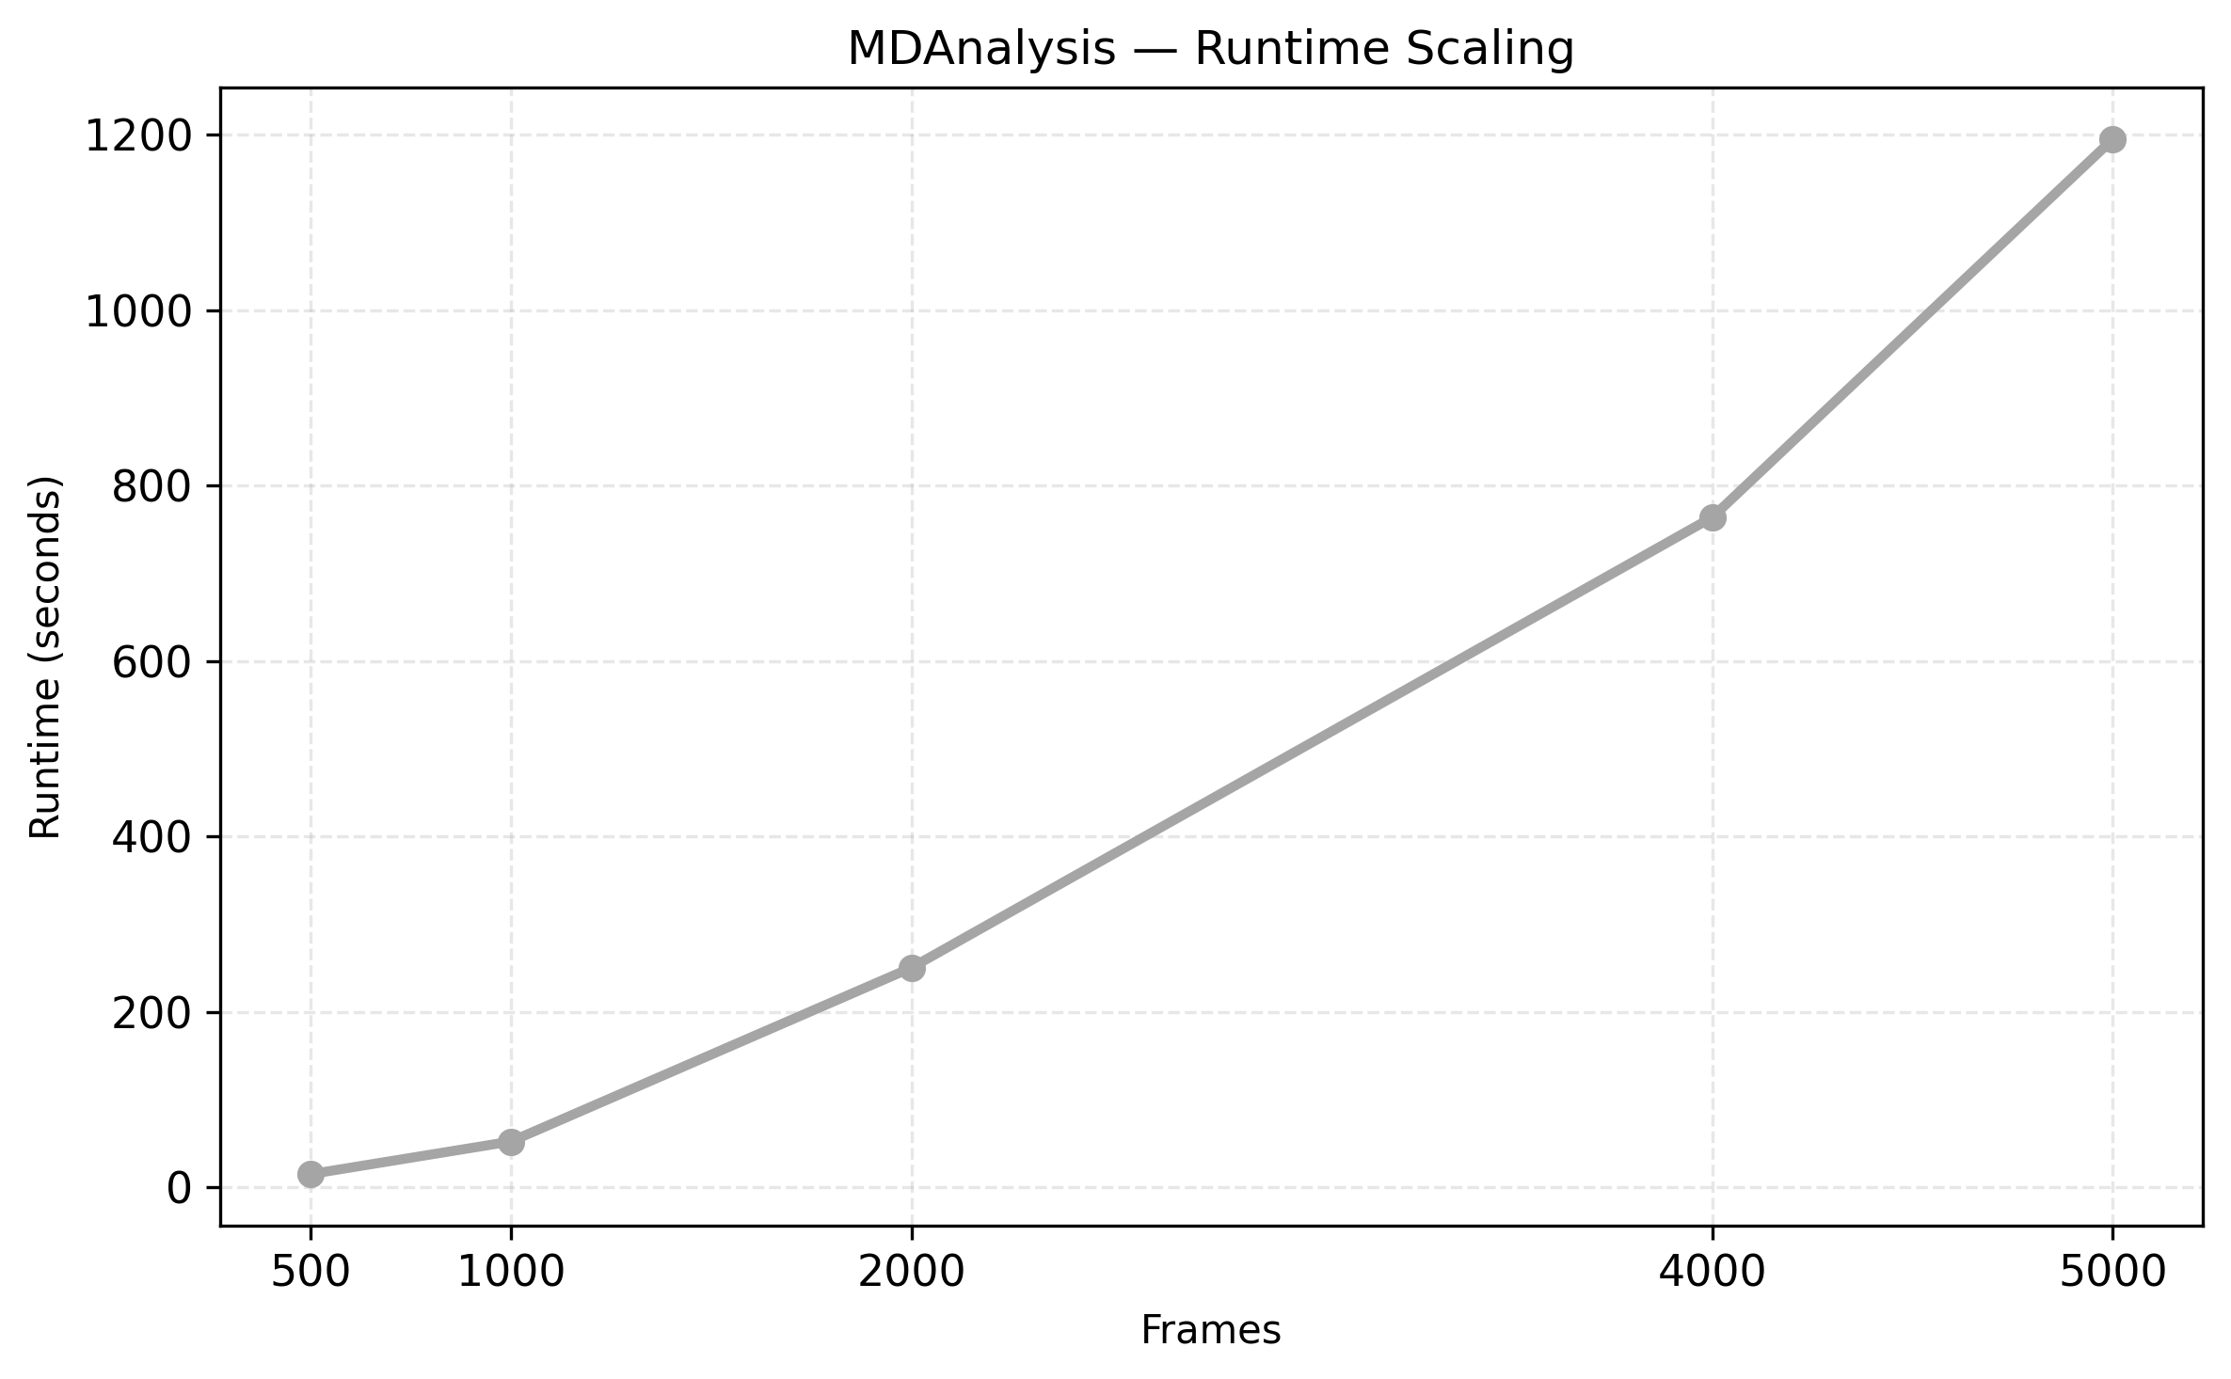
MDAnalysis Runtime Scaling

Slide 11
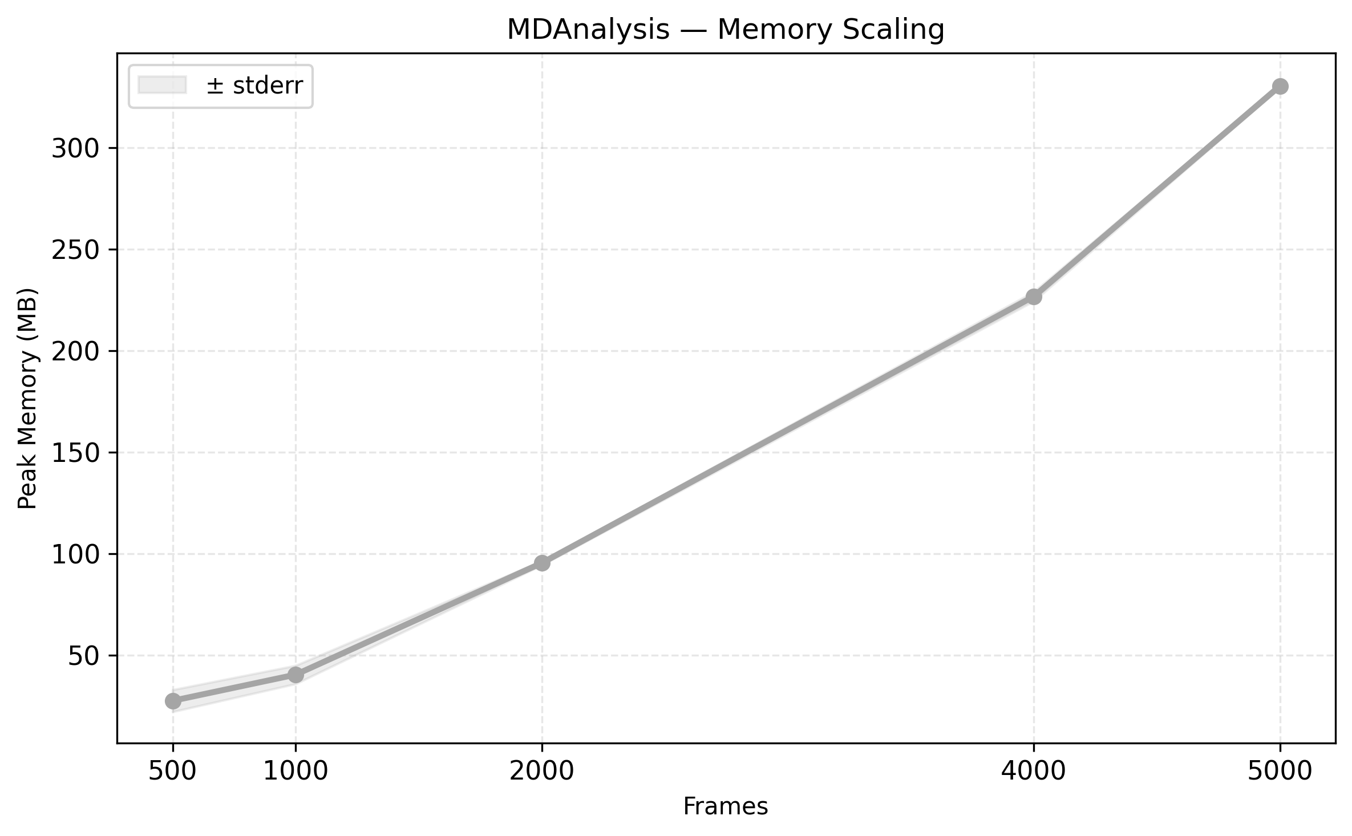
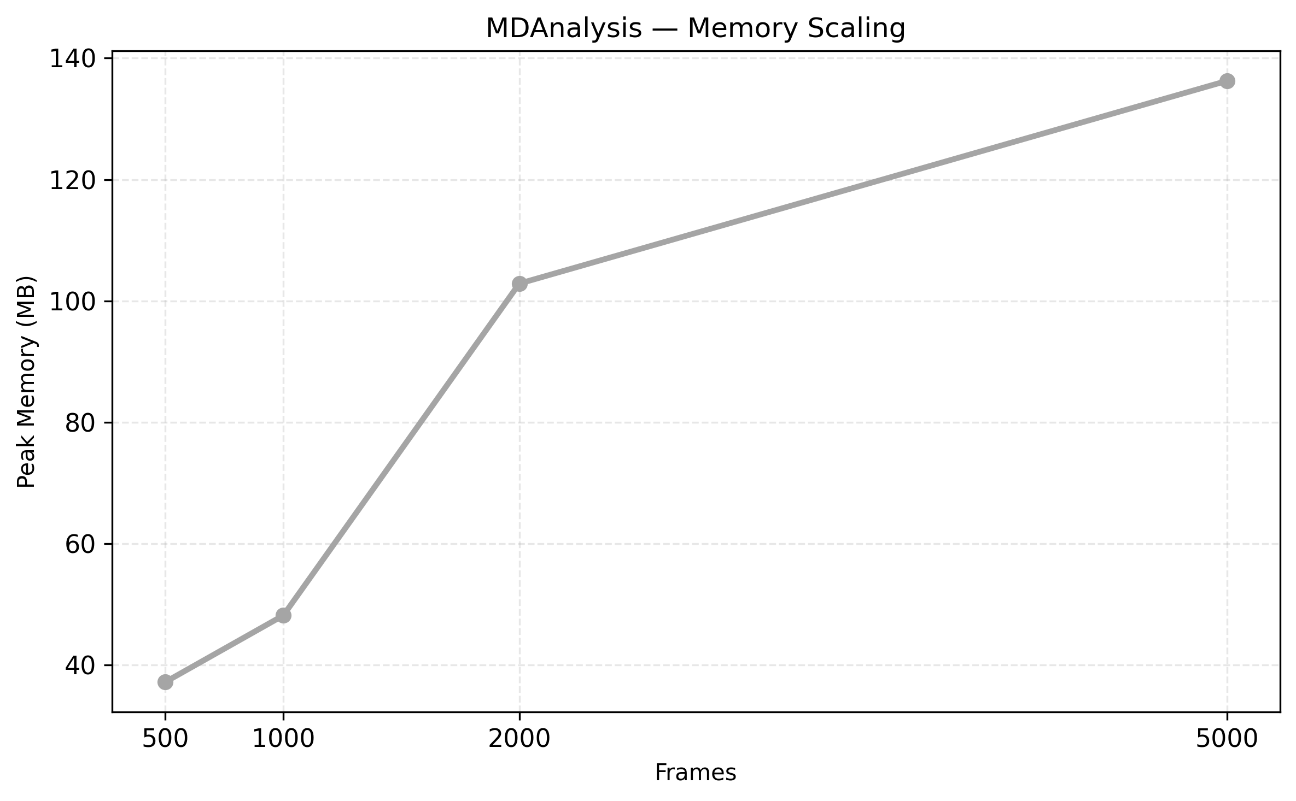
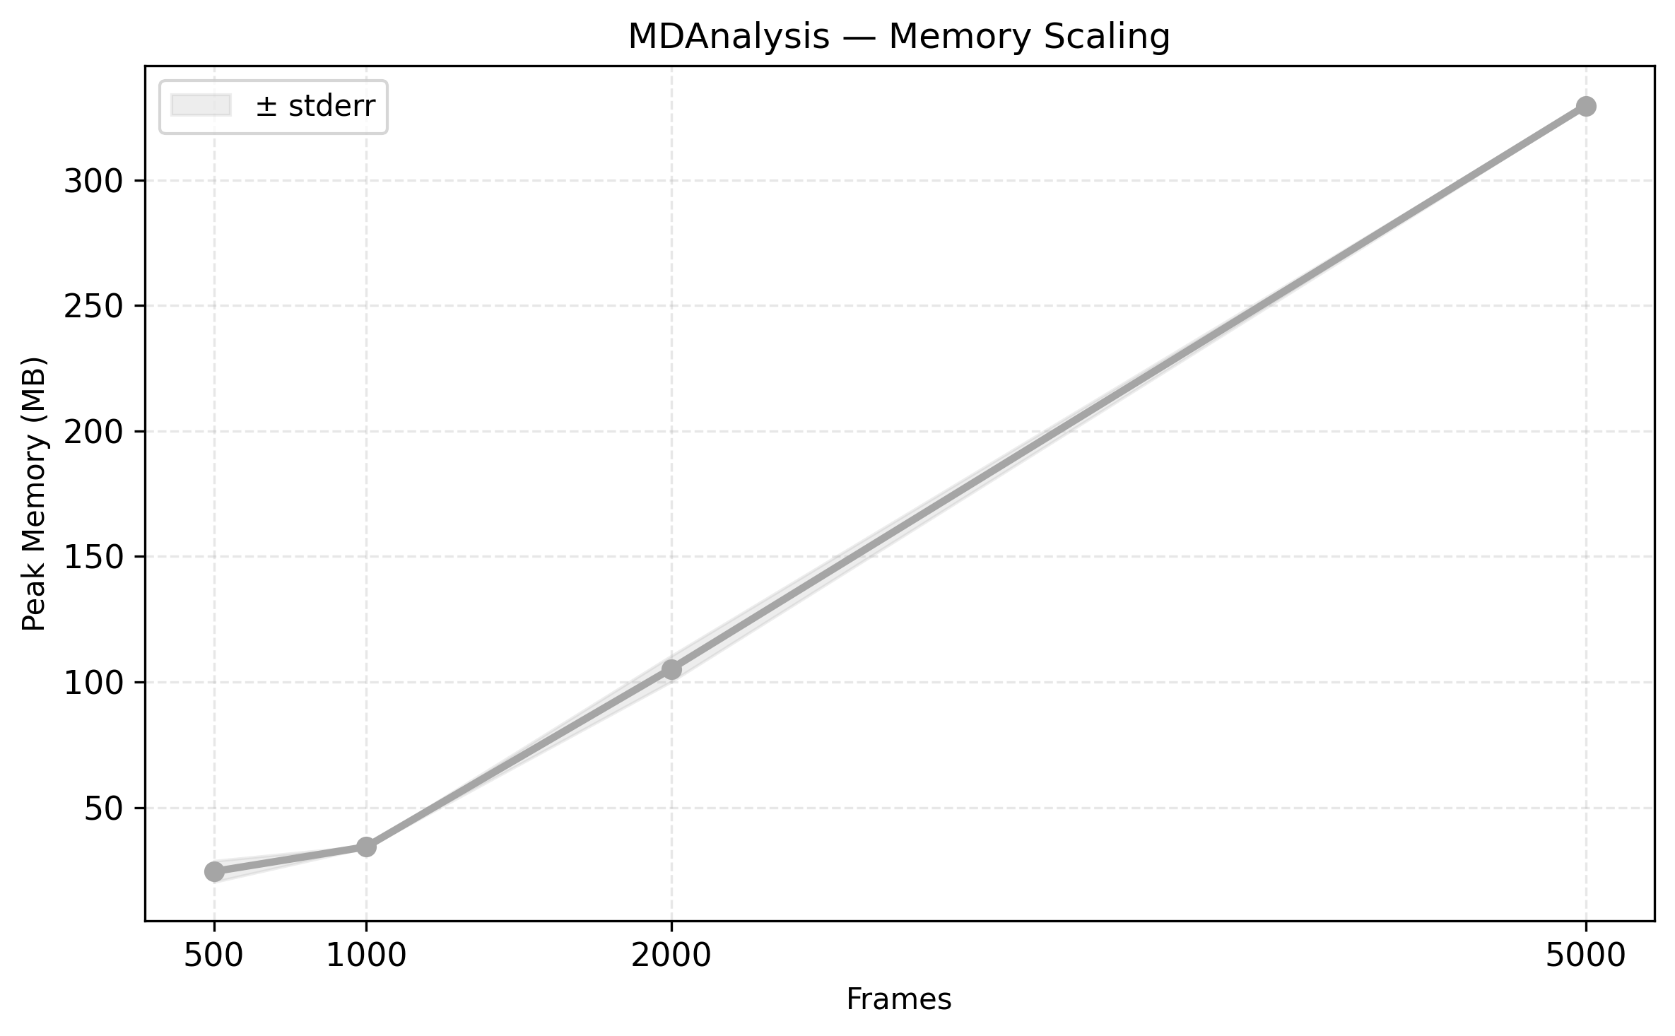
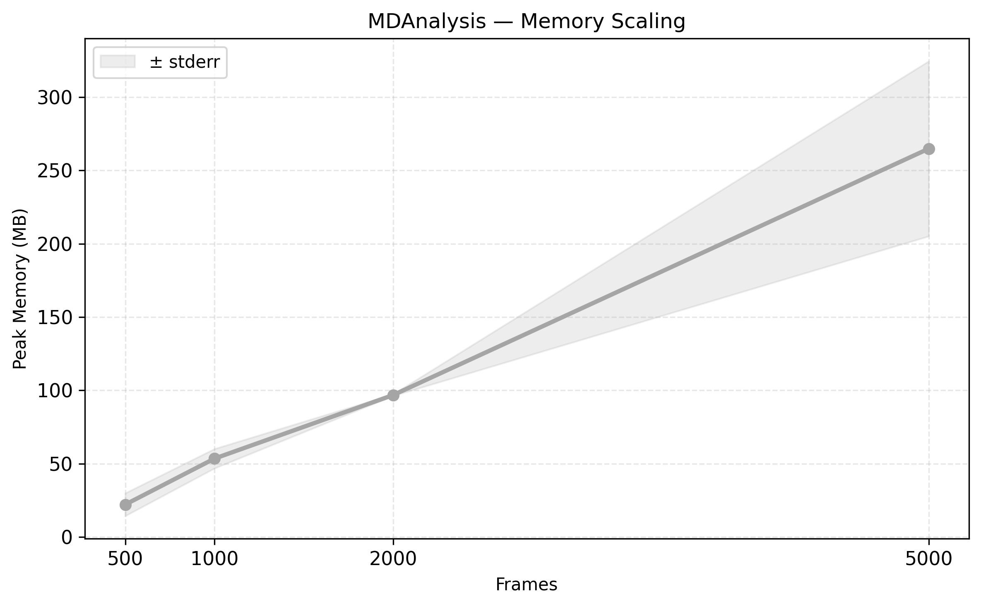
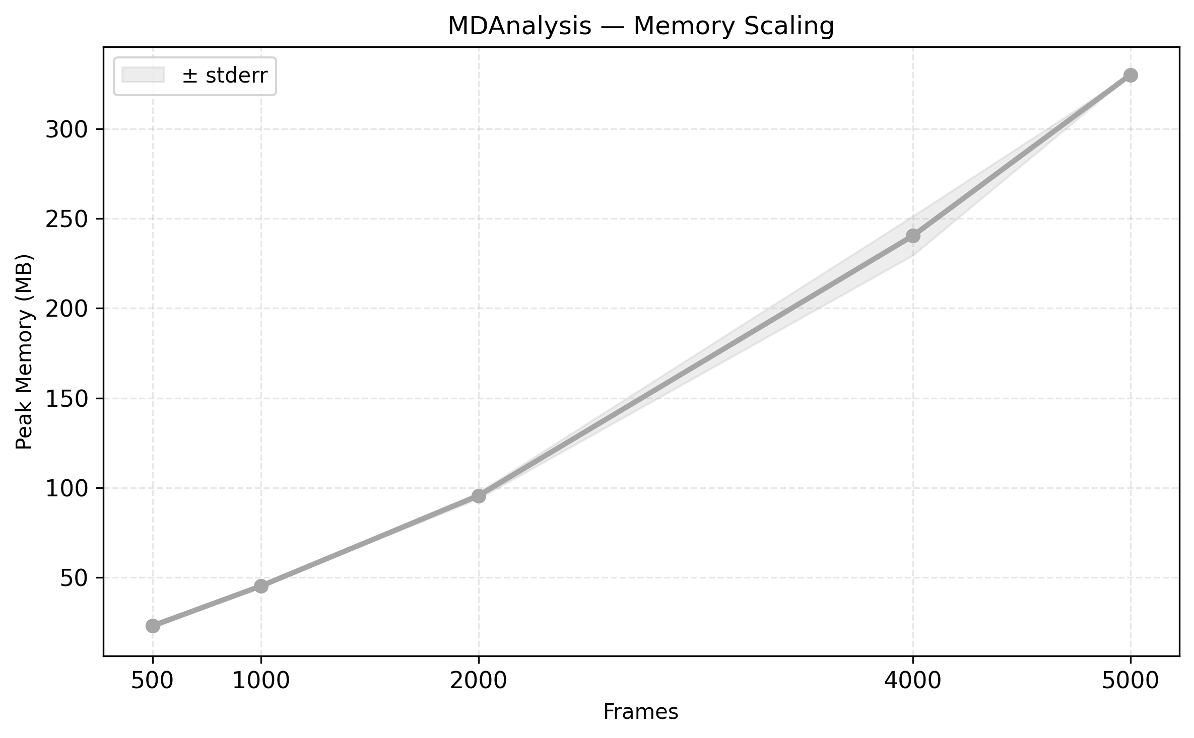
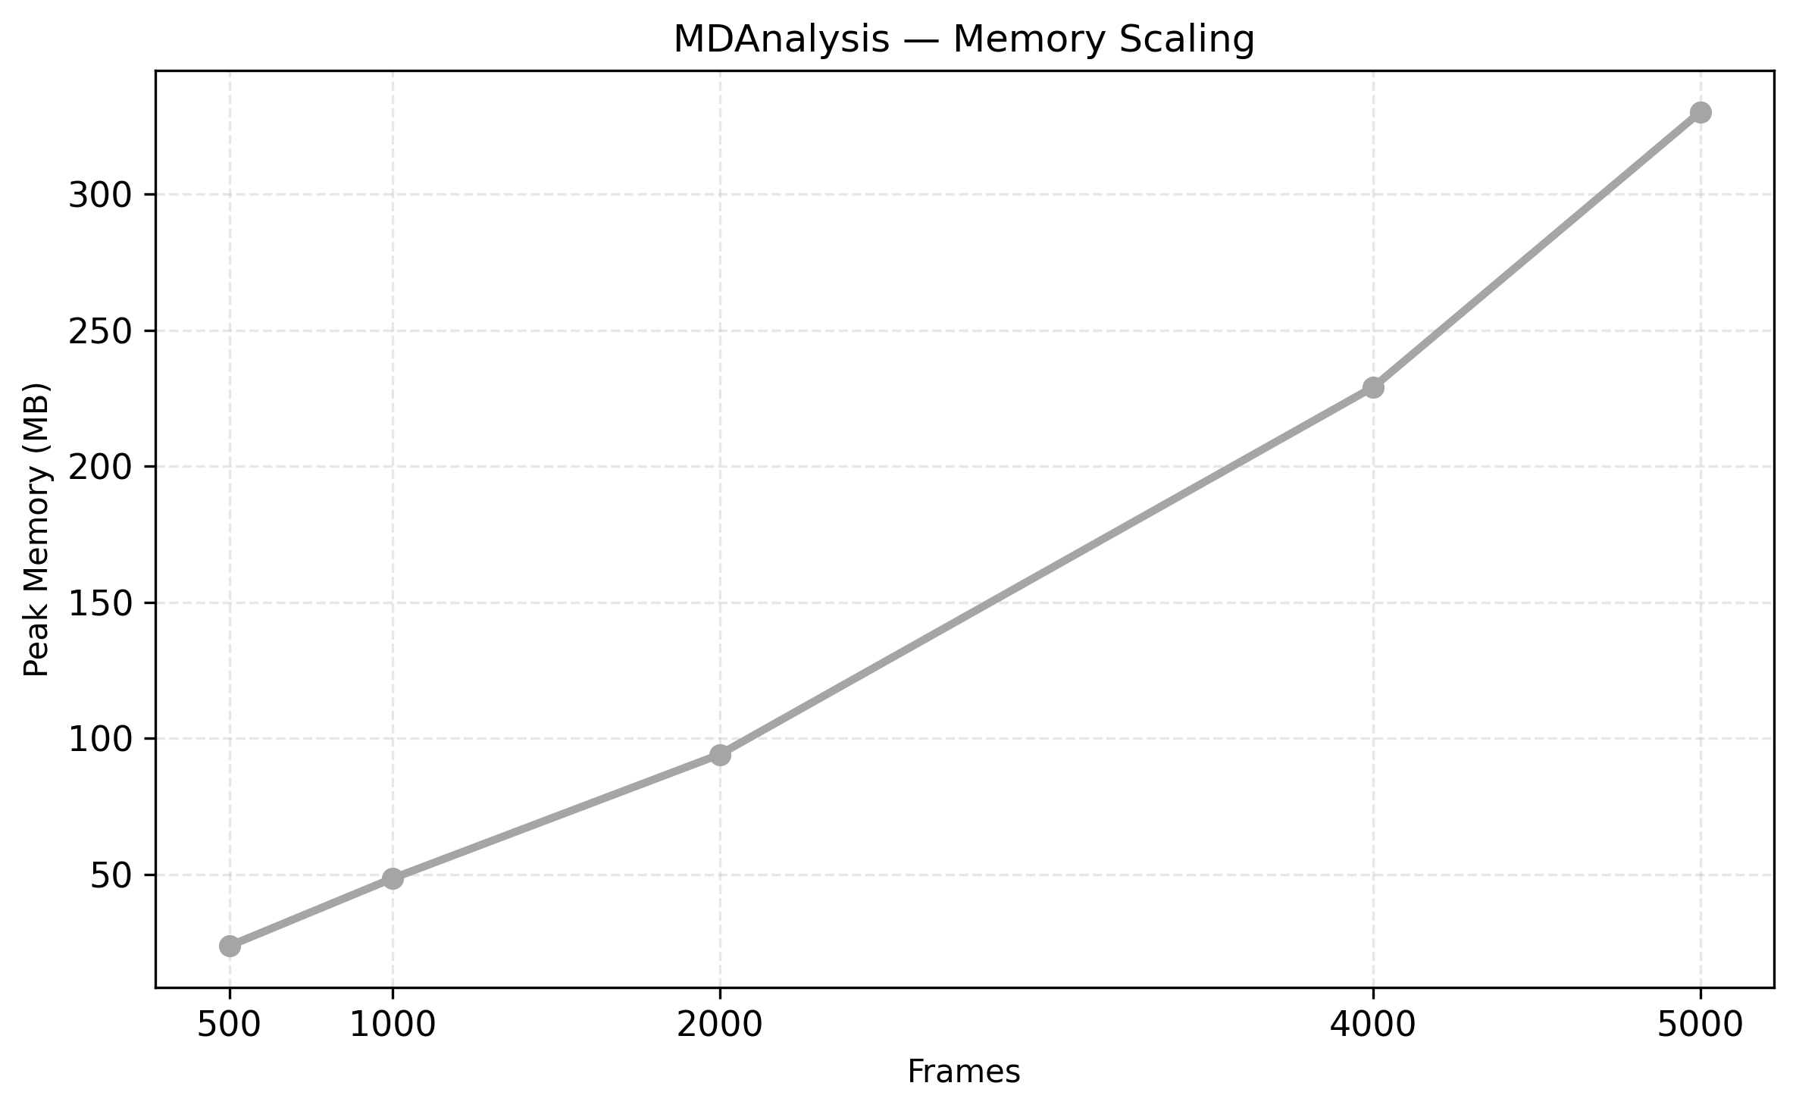
MDAnalysis Memory Scaling

Slide 12
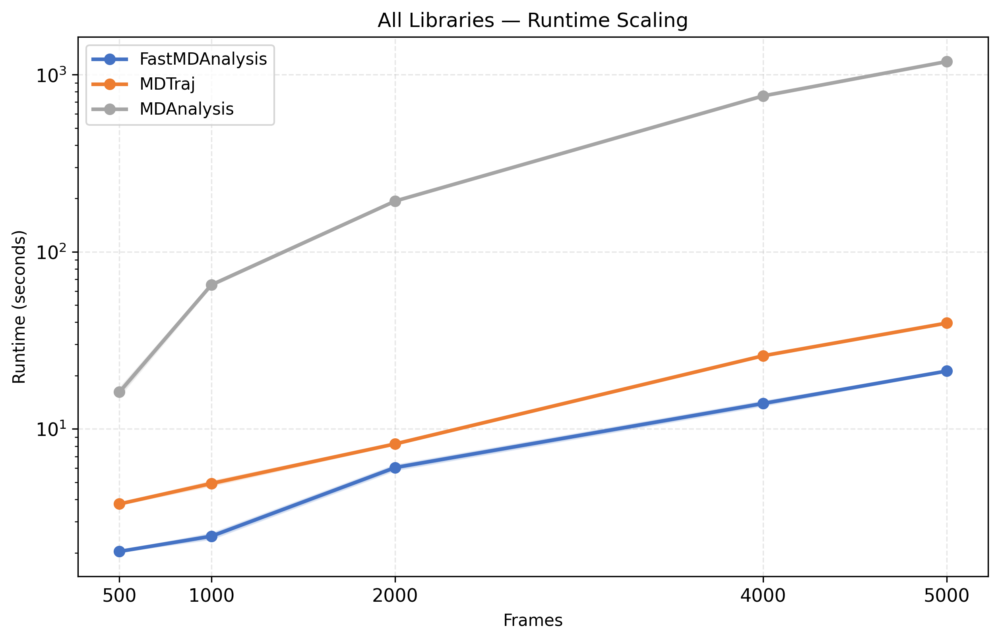
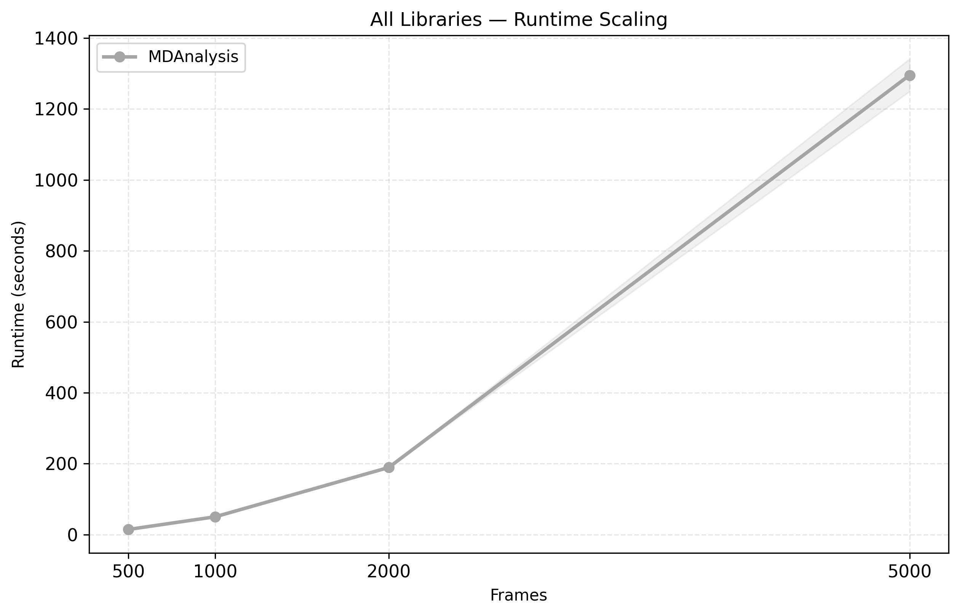
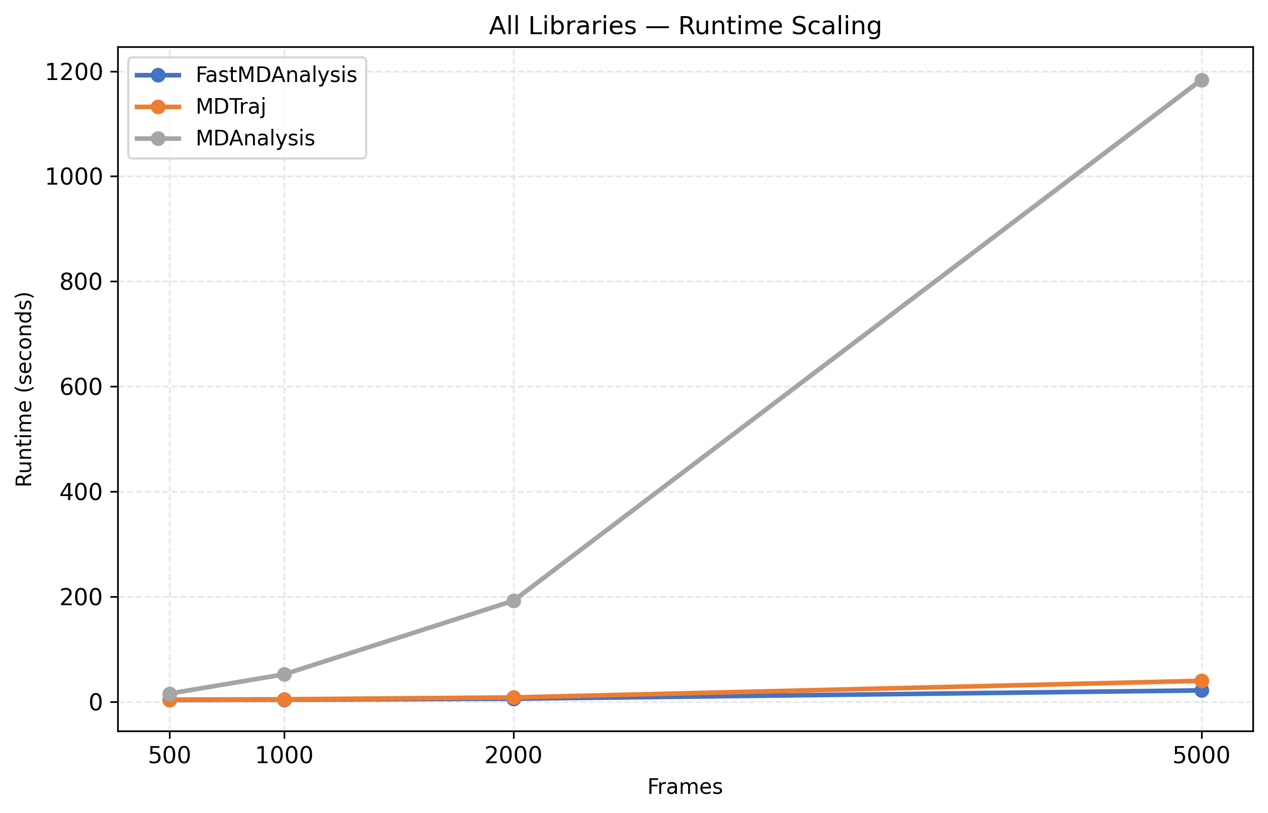
Combined Runtime Scaling

Slide 13
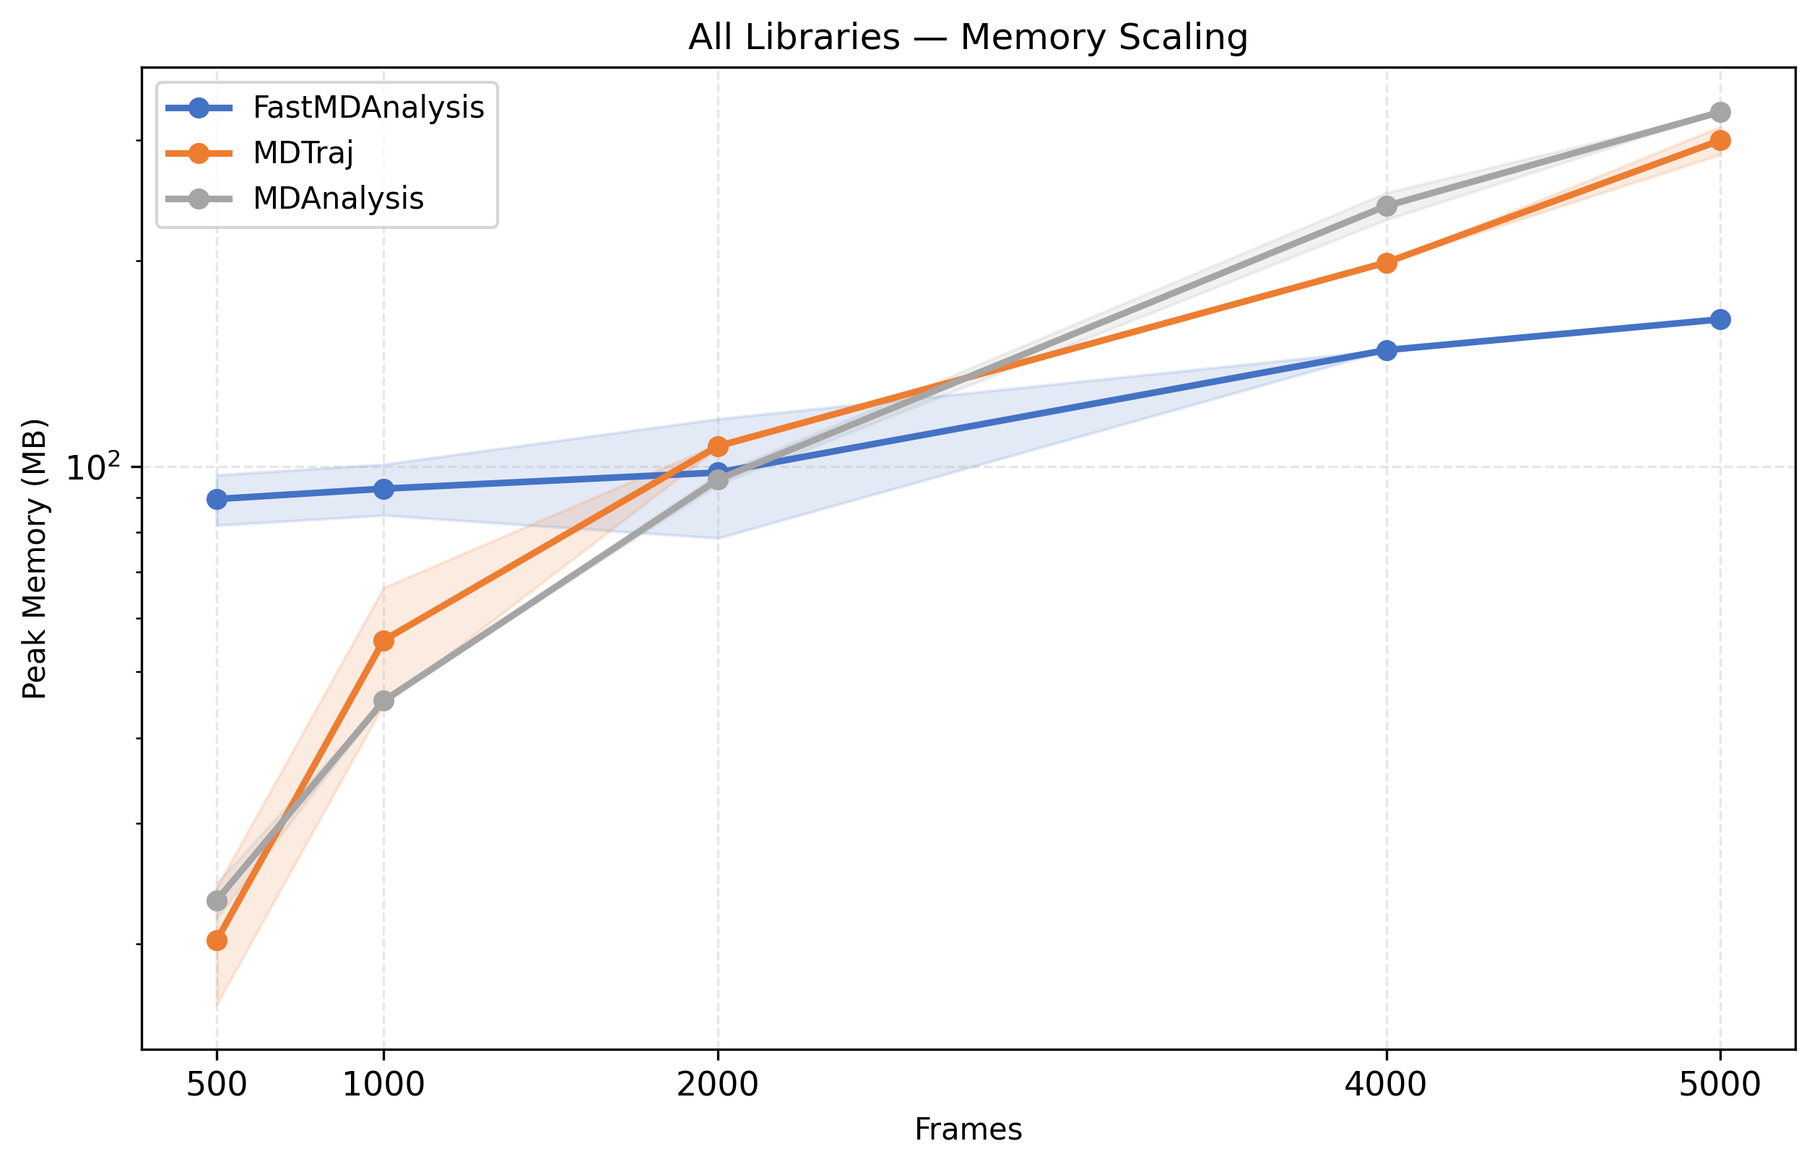
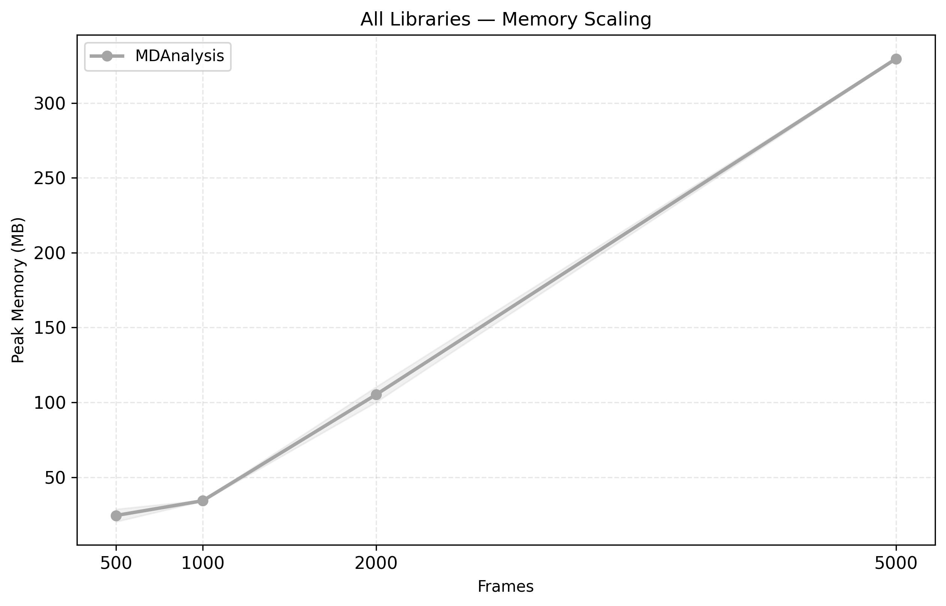
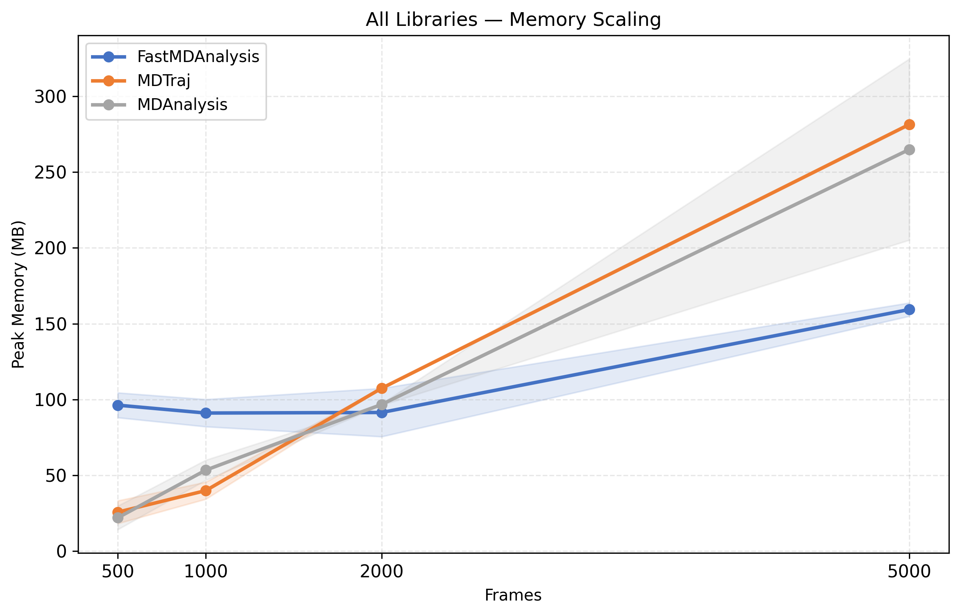
Combined Memory Scaling

Slide 14
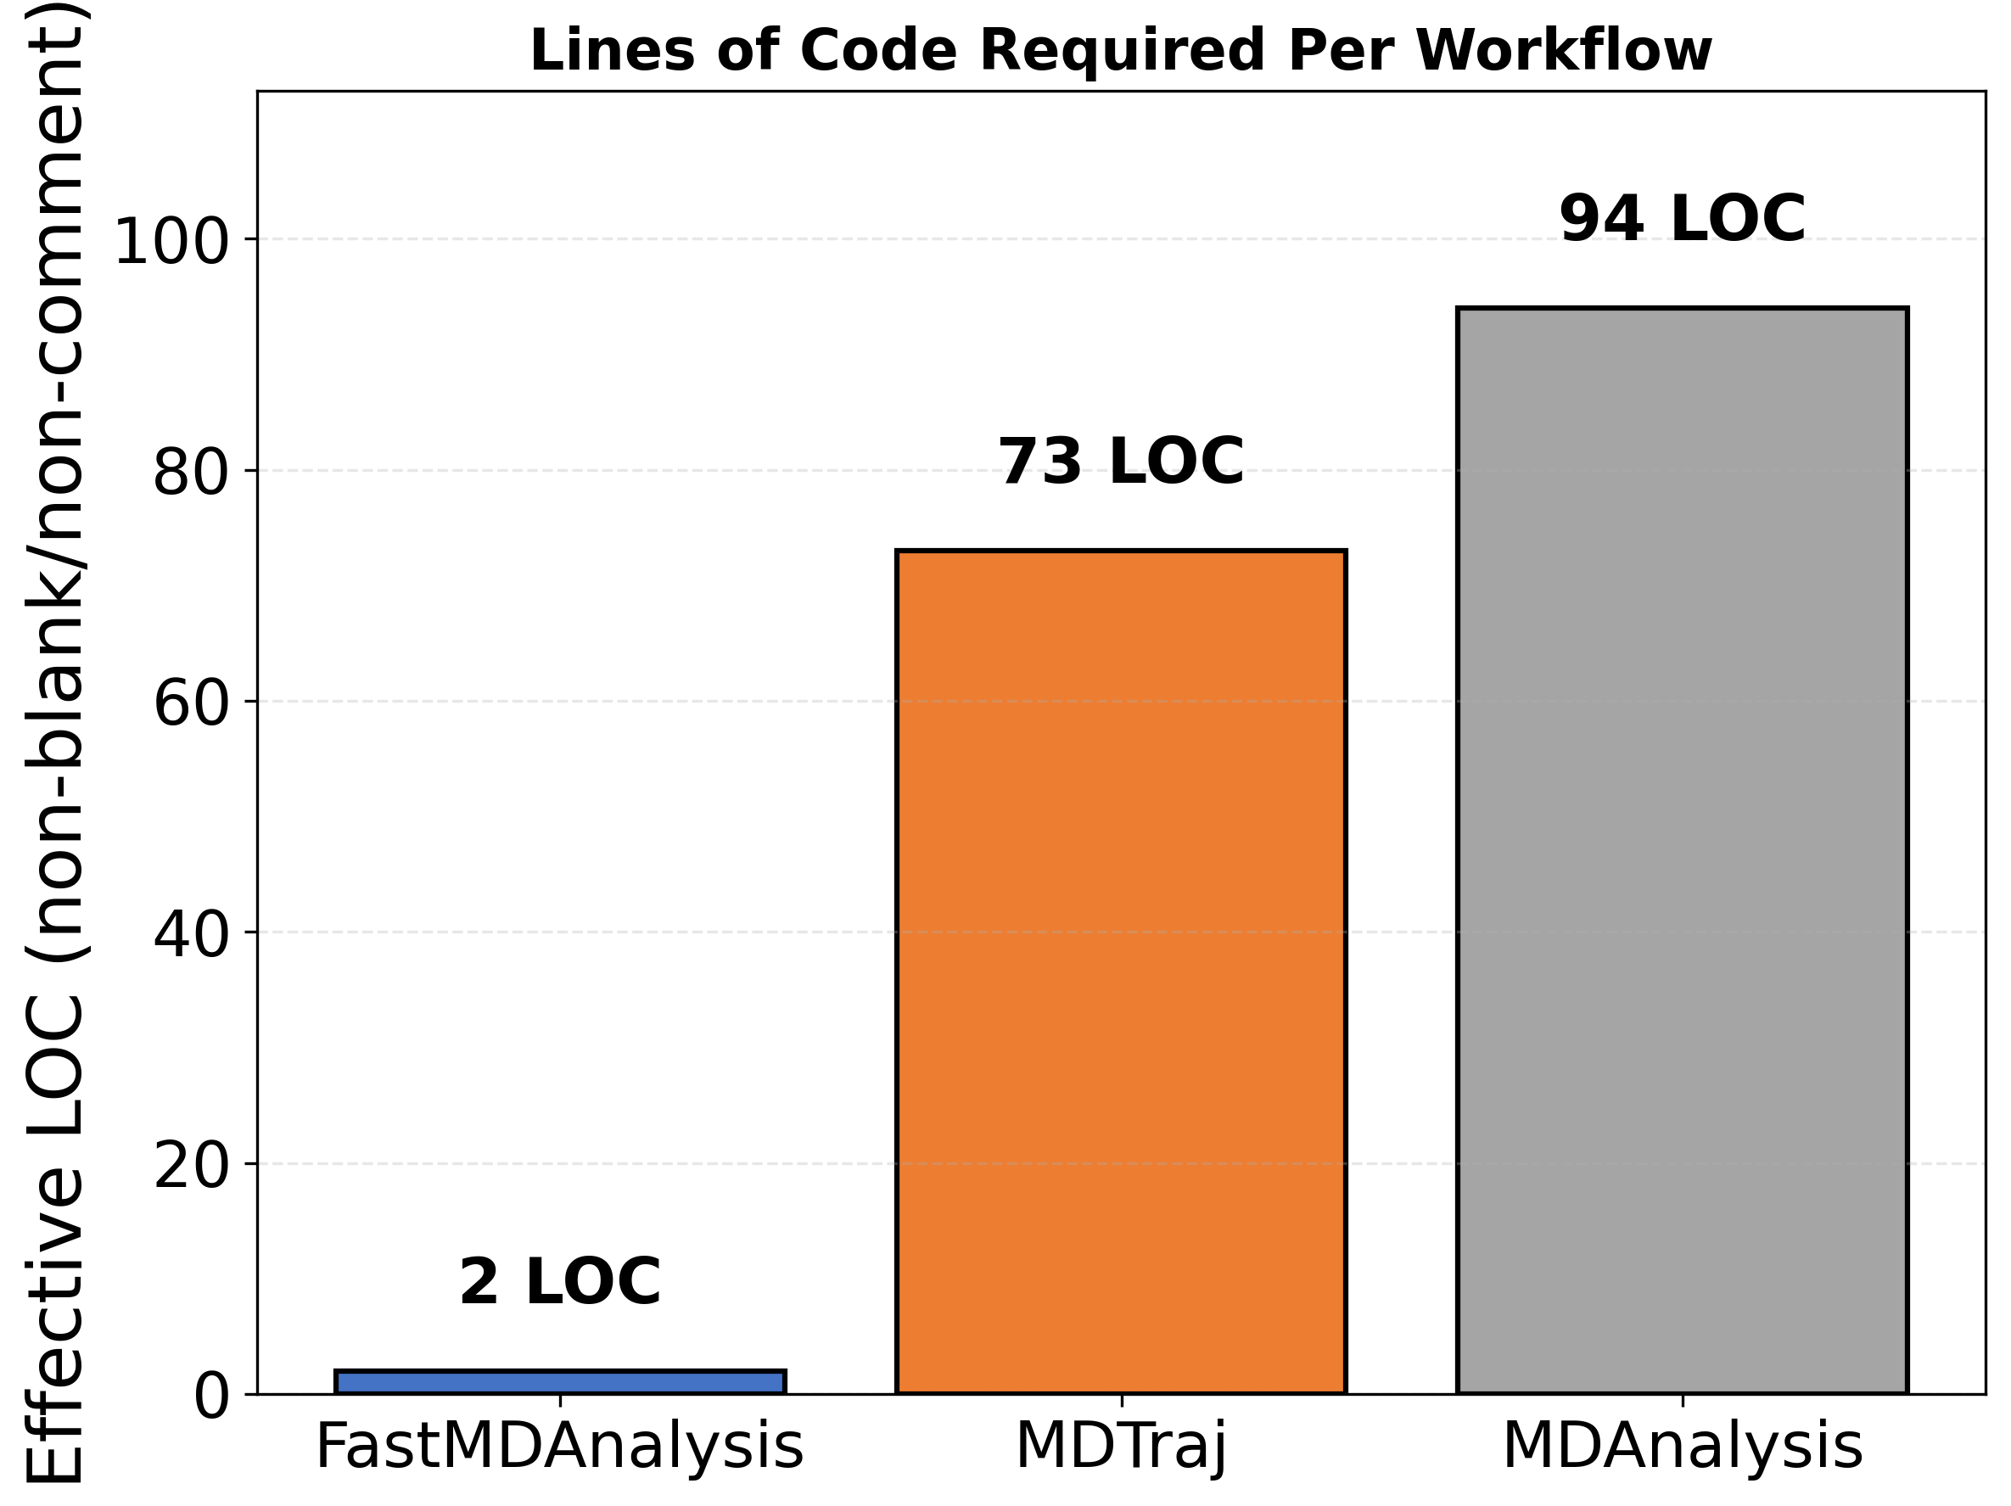
Lines of Code Comparison

Slide 15
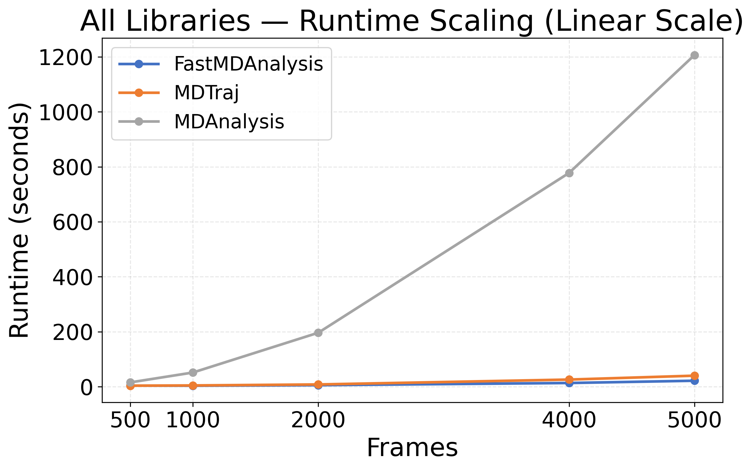
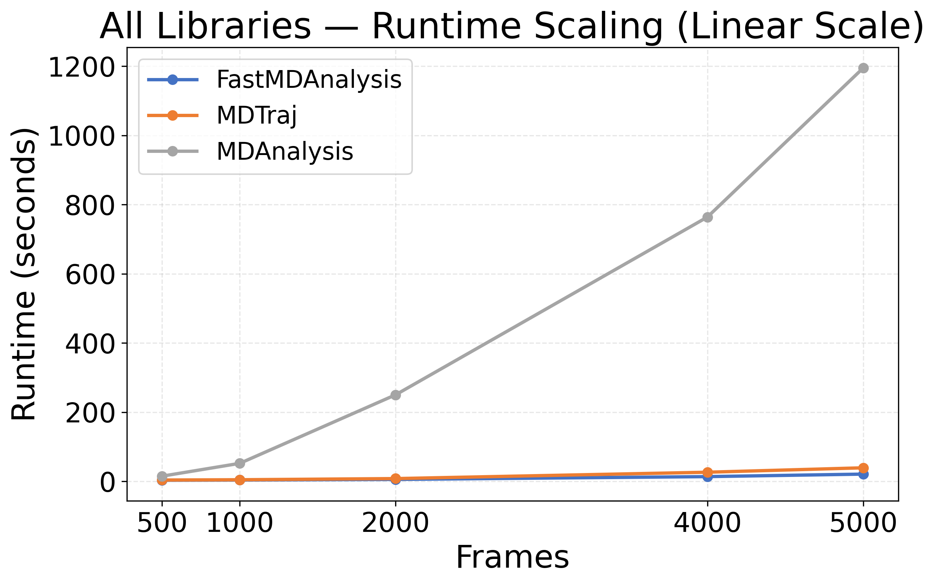
Combined Runtime Scaling (Linear)

Slide 16
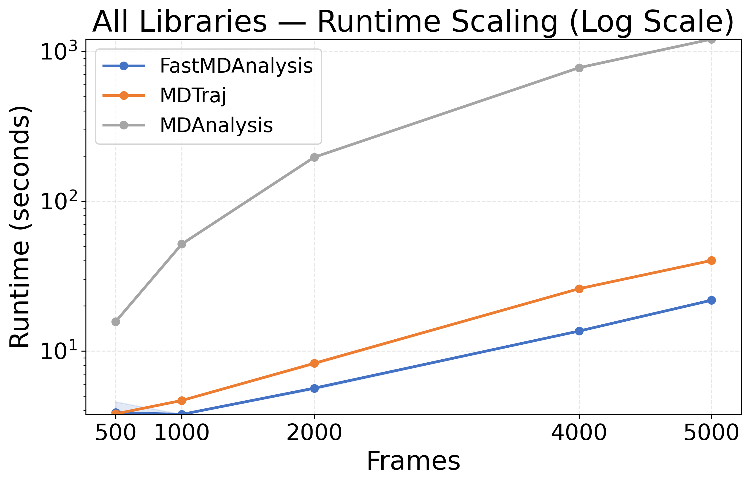
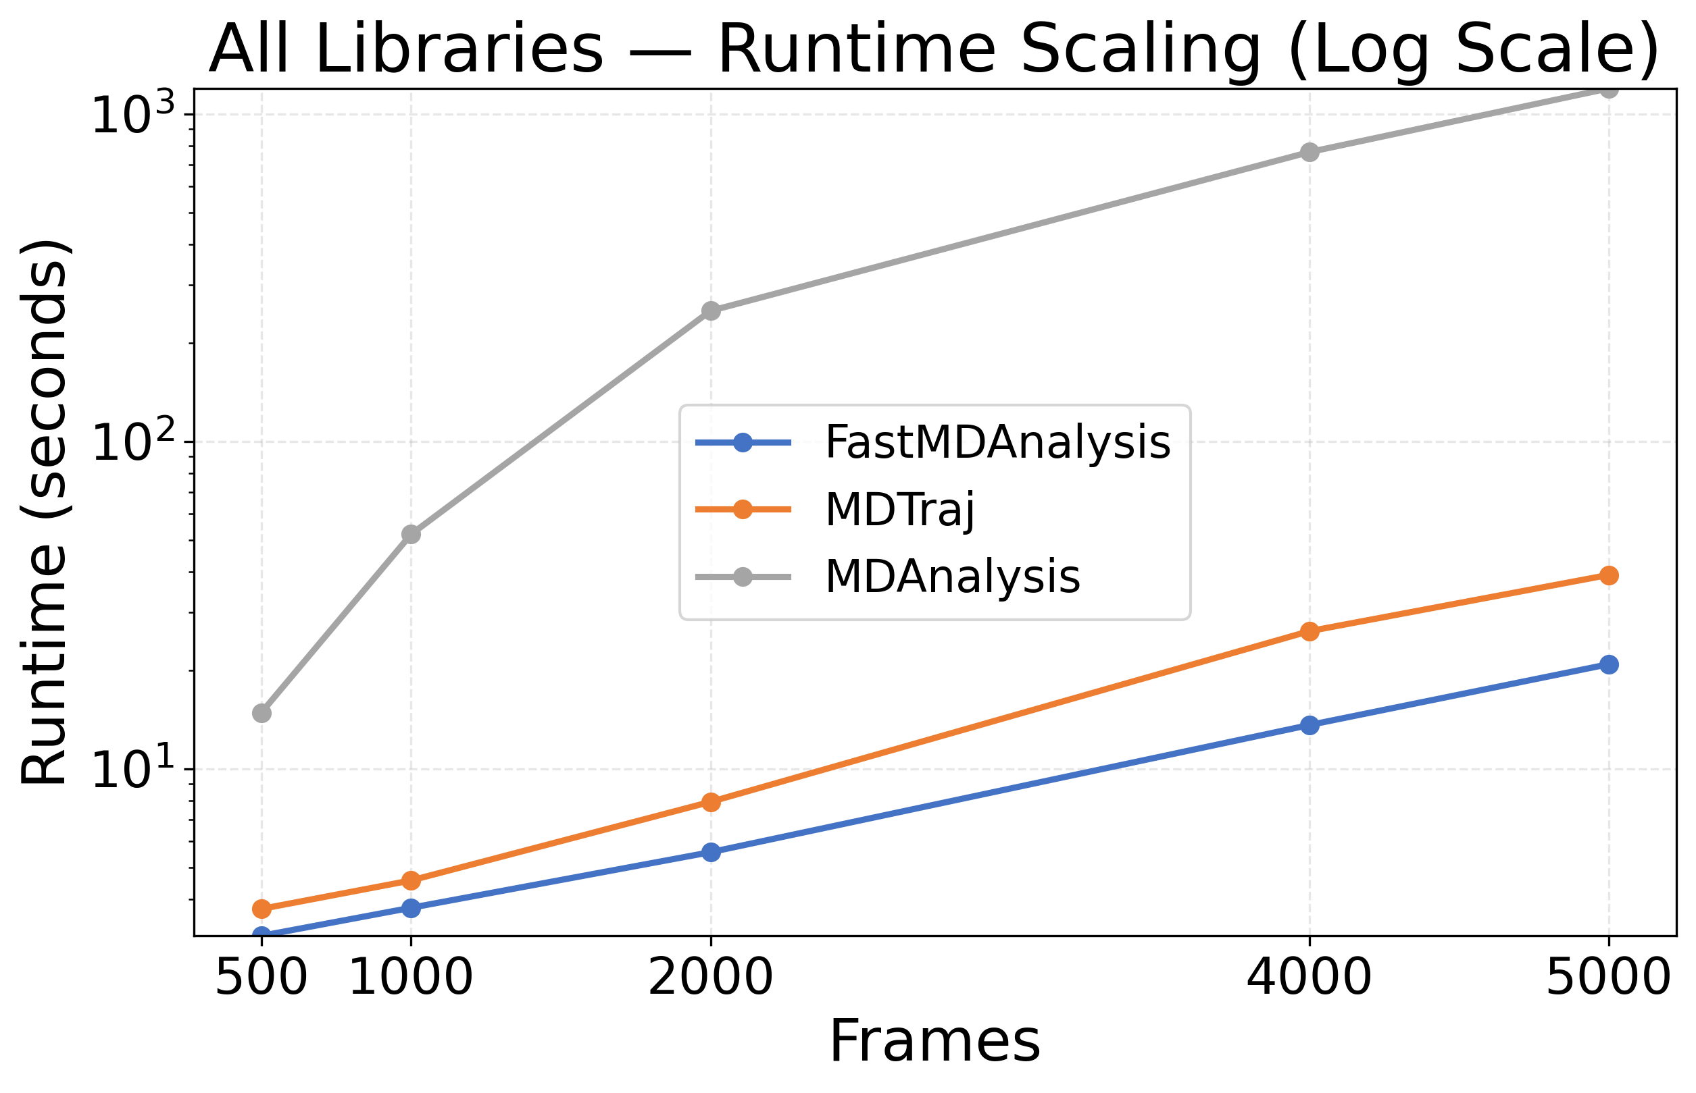
Combined Runtime Scaling (Log)

Slide 17
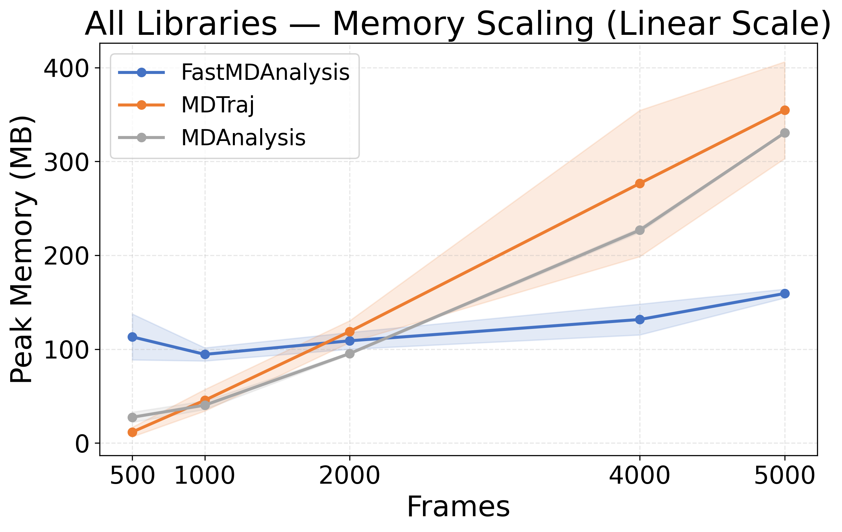
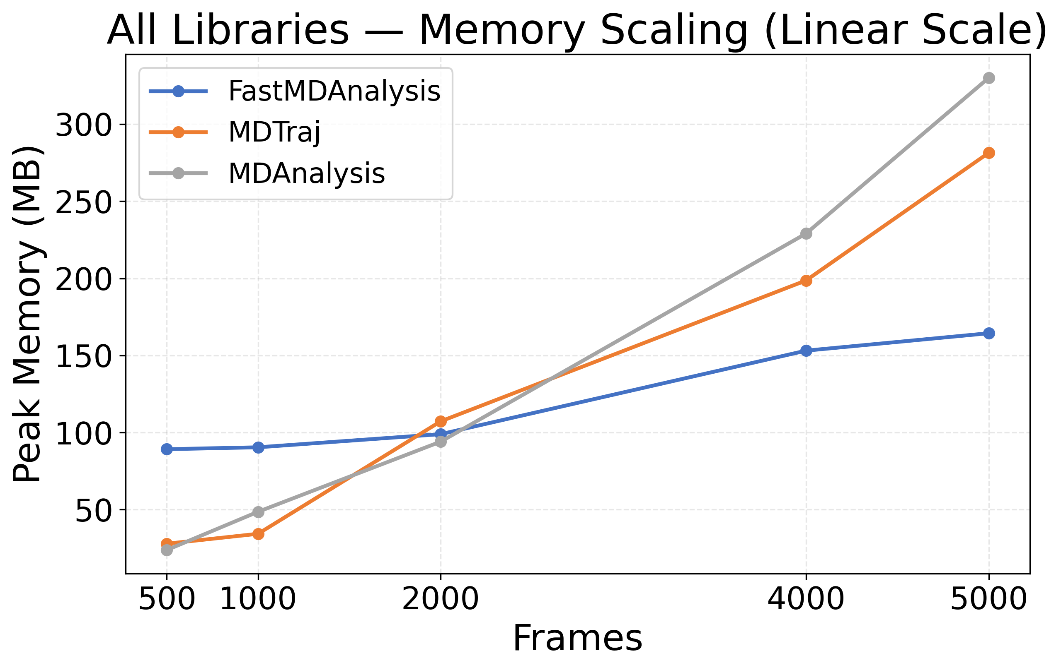
Combined Memory Scaling (Linear)

Slide 18
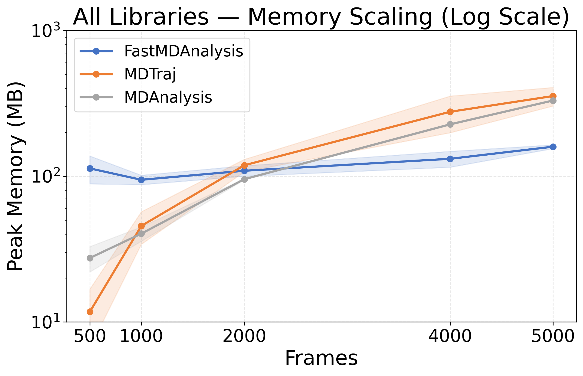
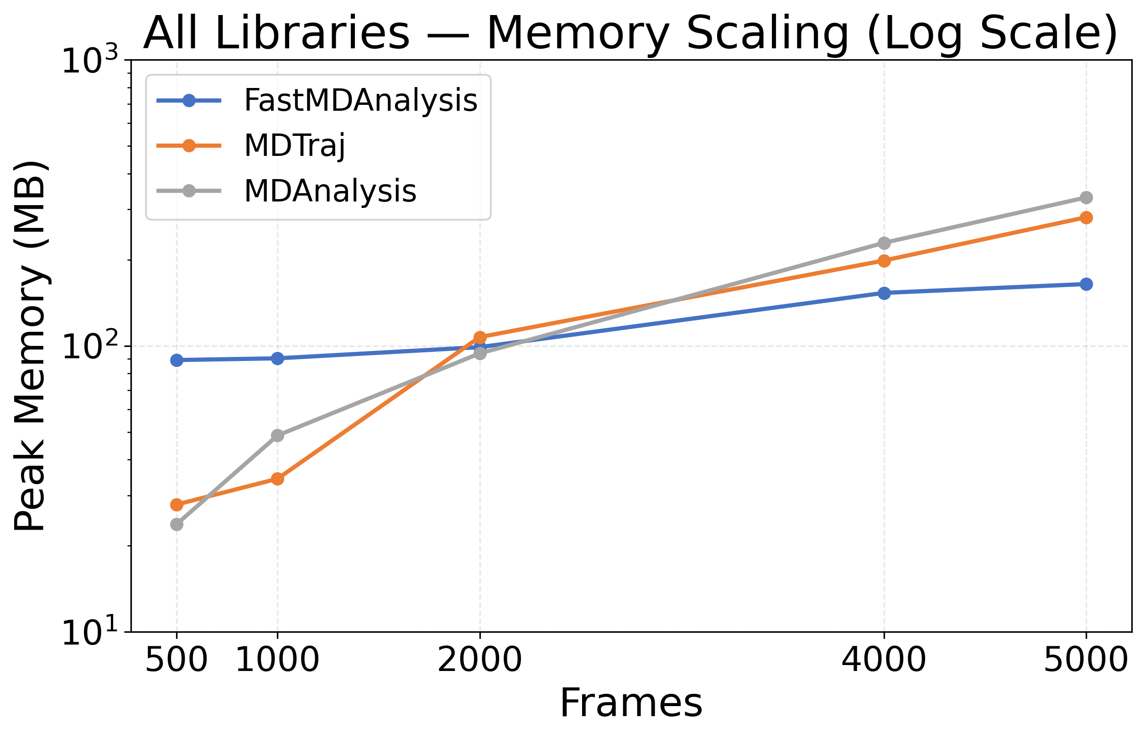
Combined Memory Scaling (Log)

